Slide 1

2025-26 Financial Aid Updates
OPU Counselor Conference
October 21, 2024

Slide 2
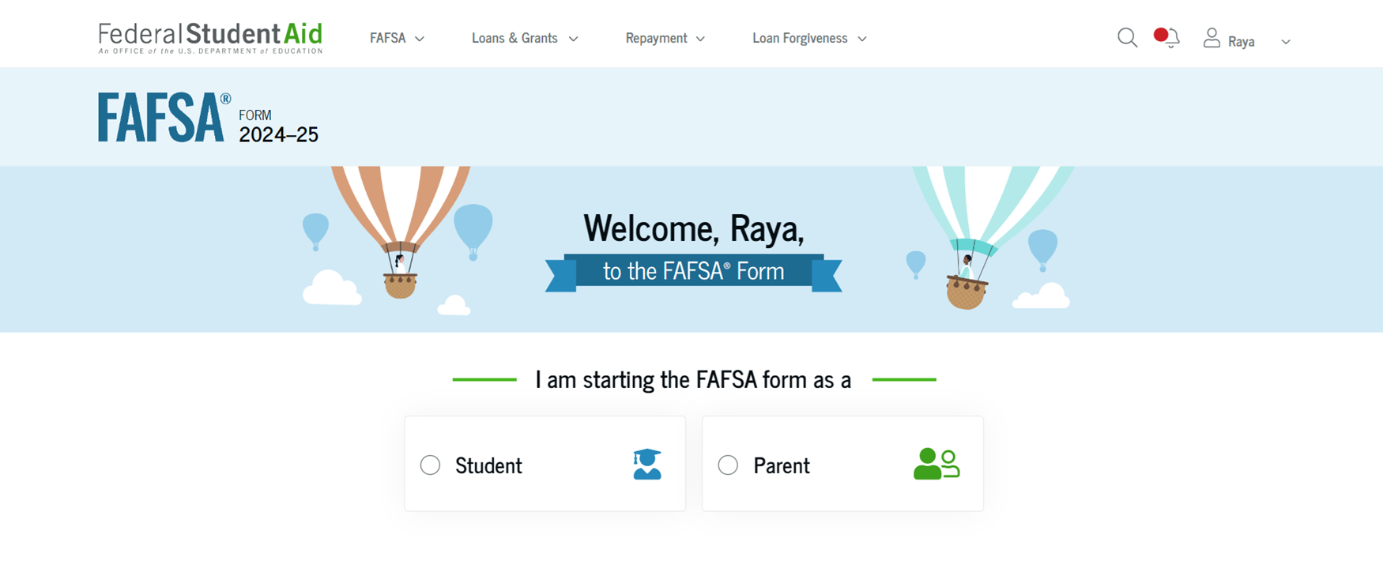
“New” FAFSA December 1, 2024
Notes:
Delayed so they do a beta release and try to find and fix most errors and bugs before the form becomes publicly available. The beta release began on October 1 and an anticipated public release on or before December 1

Slide 3
2025-2026 Beta Testing Updates
Phase 2 began 10/15
As of 10/18, 1,735 FAFSAs successfully filed out of 2,365 students
No critical errors have been reported
Still on track for a December 1 launch date
Notes:
Phase 1 was primarily high school students filing through 6 community-based organizations. They hosted FAFSA completion events with in-person support from FSA. Phase 2 does not have the in-person support, but there is a beta help support line. Phase 2 expanded the number of community-based organizations and also welcomed several colleges and universities so that returning students could try and file.
No critical errors, though there are still some frustrating issues. The form is letting people submit without signing their FAFSA similarly to the 2024-25 application. There has also been an error message several folks have received at the top of the page when progressing through the FAFSA – it’s non-descriptive and FSA hasn’t found any actual errors tied to it, but it does tell people to close the form and try again later.

Slide 4
Beta Testing Updates
https://fsapartners.ed.gov/beta/Updates
https://fsapartners.ed.gov/beta/Data

Slide 5
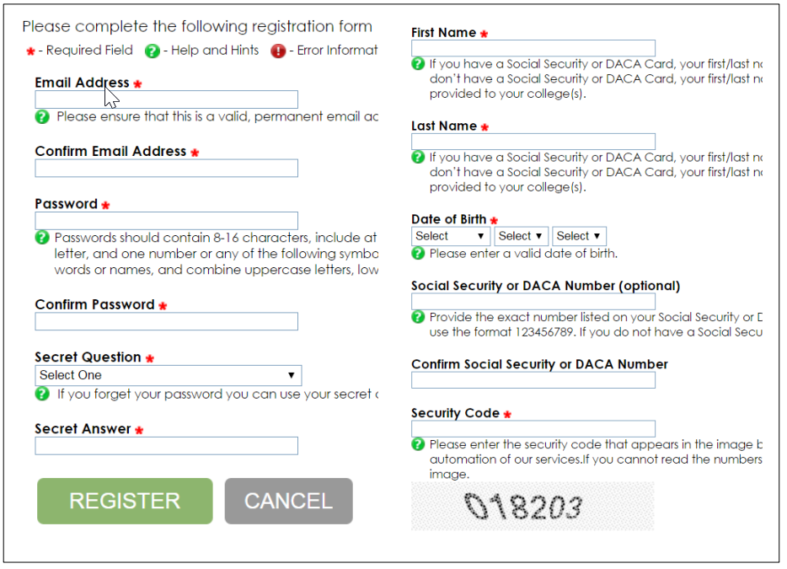
ORSAA Still Going Strong!

Slide 6






Who’s The Financial Aid Parent?
Are your parents married to each other or do they live together? | If not, what parent provided more financial support over the past 12 months? | Is the parent that provided more financial support remarried?
Both parents will report information on the FAFSA | This parent will report information on the FAFSA | Stepparent will also report information on the FAFSA
Notes:
We often get questions about who is considered a parent for purposes of financial aid. Currently, FAFSA rules are different from IRS rules, so let’s look at different family situations:
Column one: Are your parents married to each other or living together? If yes, report both parents.
Column two: If not, what parent provided more financial support over the past 12 months? This will be the parent who will report information on the FAFSA.
Column three: If the parent from column two is married, then report both that parent and the stepparent on the FAFSA.
In the next slide, we’ll discuss situations in which the student doesn’t live with their parent.

Slide 7




Non-Financial Aid Parents
Widowed Stepparent
Sibling
Grandparent
Foster Parent
Extended Family
Legal Guardian
Notes:
The people listed on this slide are not the student’s parents for financial aid purposes unless they have legally adopted the student, so they cannot go on the parent section of the FAFSA. Let’s look at them now:
If a student was living with a biological or adoptive parent who was married to the student’s stepparent, and the parent passes away, the widowed stepparent is no longer the financial aid parent on the FAFSA.
Even if you live with your grandparent or another relative or friend, you cannot put them on your FAFSA as your parents—again, unless they’ve adopted you. In that case, they’ve become your adoptive parent. If you live with your grandparent, for example, and your parent or parents live down the street, you will need to use them on your FAFSA. Even if your parents live in another state or country, you must usually use their information and 2023 income and/or tax return on your FAFSA--even if they didn’t work in the U.S!
If you live with a foster parent or legal guardian, then you’ll check the appropriate box on the FAFSA student dependency section to be considered independent for financial aid purposes and you will not have to supply anyone else’s information on the FAFSA.
I’ll be happy to answer questions about these situations after the presentation!

Slide 8
Online Parent Wizard
https://studentaid.gov/fafsa-apply/parents

Slide 9
Federal Pell Grant Eligibility
Single-Parent Family 2025-26
Family Size | Maximum Pell Eligibility | Pell Eligible* | Not Pell Eligible*
2 | < $44,370 | < $64,090 | $64,090+
3 | < $55,935 | < 80,795 | $80,795+
4 | < $67,500 | < $97,500 | $97,500+
5 | < $79,065 | <$114,205 | $114,205+
Notes:
For a student in a single-parent family, FAFSA will use the adjusted gross income from 2023 to calculate the student’s Pell Grant eligibility. You can use this table to look up family size and family income to see if you are potentially Pell Grant eligible.

Slide 10
Federal Pell Grant Eligibility
Two-Parent Family 2025-26
Family Size | Maximum Pell Eligibility | Pell Eligible* | Not Pell Eligible*
3 | < $43,505 | < $68,365 | $68,365+
4 | < $52,500 | < $82,500 | $82,500+
5 | < $61,495 | < $96,635 | $96,635+
6 | < $70,490 | <$110,700 | $110,700+
Notes:
For a student in a two-parent parent family, FAFSA will use the adjusted gross income from 2023 to calculate the student’s Pell Grant eligibility. You can use this table to look up family size and family income to see if you are potentially Pell Grant eligible.

Slide 11
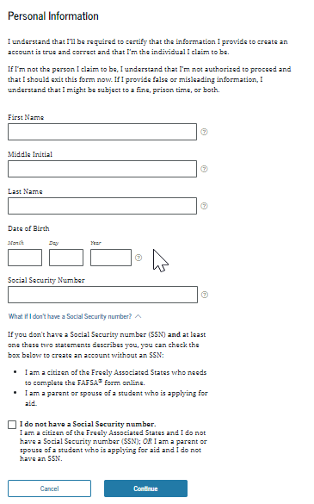
Federal Student Aid ID (FSA ID)
Students
Parents (if possible)
Unique to each individual
Used for FAFSA
Used for student loans
Notes:
The first step to completing the FAFSA is to create an FSA ID. It’s just an account with a username and password that allows students to sign the FAFSA electronically. It’s also used to apply for federal student loans. Dependent students should also have their parent(s)/contributor(s) apply for a separate FSA ID so they can sign the student’s FAFSA too.
FSA IDs have to be very secure because they’re connected to Social Security numbers. If your parent does not have a Social Security number, they will set up an FSA ID but will check the “I do not have a Social Security number” box.
You will need to provide a unique email address and cell phone number for your FSA ID. Two people cannot share this same contact information for their FSA IDs. If you ever forget your password, you can reset it easily by having a code texted or emailed to you.
--------------------------------------------------------
(Preparing for FSA ID handout: one page front and back)

Slide 12
FSA ID: Next Steps
1
2
3
Receive email from U.S. Department of Education
Identity verified in
1-3 days
Complete FAFSA
Notes:
If a contributor has a Social Security number (SSN), their information is then sent to the Social Security Administration (SSA) for confirmation. The confirmation process takes about one to three days. If the information doesn’t match SSA’s records, the discrepancies will have to be resolved, possibly delaying the financial aid application and awarding process. Therefore, if a contributor thinks SSA might have the wrong name or date of birth for them in its records, they should go—well ahead of applying for aid—to ssa.gov to find out how to correct any errors. The information must be correct before their StudentAid.gov account can be used for most of its purposes
(Source: https://financialaidtoolkit.ed.gov/resources/2024-25-counselors-handbook.pdf (Page 22))

Slide 13
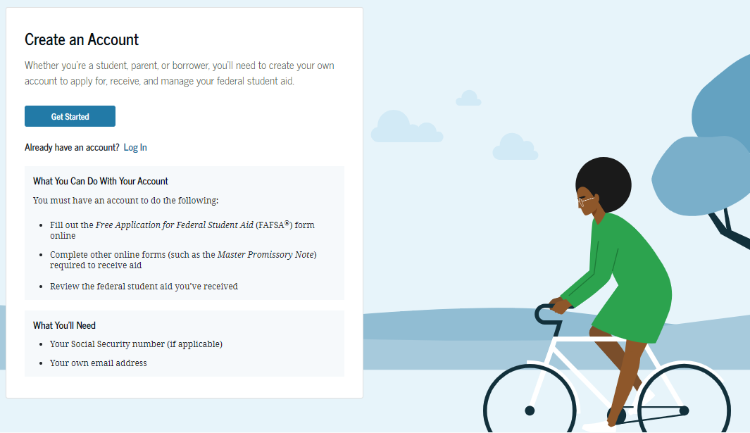
FSA ID: Undocumented Contributors
Notes:
If folks do not have an SSN, FSA has still waived most of the more tedious (and seemingly impossible when trying) steps to verify identity if the trans union question check is failed. There is allegedly going to be an electronic form folks can complete to submit their verification documentation by the time the FAFSA is available to the public.

Slide 14





Federal Grants
Federal Pell Grant
Federal Supplemental Educational Opportunity Grant (FSEOG)
Teacher Education Assistance for College and Higher Education (TEACH)
Notes:
Let’s start with grants—federal grants.
Federal grants are for students who are U.S. citizens or eligible non-citizens, and to receive federal grants, students must complete the Free Application for Federal Student Aid (or FAFSA), which we’ll cover shortly.
Federal Pell Grants are given to lower-income students based on the information on the FAFSA. As soon as you hit the “submit” button on the FAFSA, you’ll see your Pell Grant eligibility on the confirmation page that appears. Pell Grants are great because they’re portable. You can use that money at any school that participates in Federal Student Aid programs.
FSEOG, the Federal Supplemental Educational Opportunity Grant, works differently. It’s a pot of money that the federal government allocates to colleges, and they decide which students receive it. It’s intended for lower-income students, just like the Pell Grant, so most students who receive it also receive the Pell Grant. Remember, FSEOG is up to the college, so you may receive some of this funding from one school but not from another.
For the next item, “TEACH” stands for “Teacher Education Assistance for College and Higher Education,” so TEACH Grants are for students who plan to become teachers! They must agree to teach for a minimum of four years in a high-need field at a school that serves low-income students. TEACH Grants are usually not awarded until the junior and senior years of college because if a student fails to teach according to the agreement, this “grant” turns into a Direct Unsubsidized Loan that must be repaid. TEACH grants are merit based, not need based. If you’re interested, talk to your school of education when you get to college.
(Source: https://studentaid.gov/sites/default/files/federal-grant-programs.pdf)

Slide 15

Oregon Grants
Oregon Opportunity Grant
Oregon Promise Grant
Oregon Tribal Student Grant
Chafee Training and Education Grant
Notes:
The state of Oregon offers up a surprising number of grants, especially when compared with other states
OOG
OPG
Oregon Student Tribal Grant- enrolled member of one of the nine federal recognized tribes in Oregon, enrolled in an eligible Oregon college or university, complete the application AND the FAFSA or ORSAA
The Chafee Grant provides funding for foster youth or former foster youth who are continuing their education after high school
Oregon also offers the Oregon Child Care Grant, the Oregon National Guard Tuition Assistance Grant, the Barber and Hairdresser Grant, the Deceased or Disabled Public Safety Officer Grant and the Oregon Teacher Scholars Program Grant. OSAC does a LOT, including ASPIRE, and they are your go-to resource for information and funding!

Slide 16




Institutional Funds
Money provided by the college/university
Offered to incoming and current students
Check each college’s website for grant and scholarship offerings
Notes:
We have talked about federal grants, state grants, and now we will discuss institutional funds. These are funds that come from the colleges and universities themselves in the forms of scholarships and grants. This is why you will hear that a private college may be more affordable than a public college. Schools will award a certain percentage of tuition back as grants. For some private schools, this percentage is as high as 50%!
Institutional scholarships are often available and are usually funded by donors to the college or university.
Each college or university has their own criteria and application process for their institutional grants and scholarships. Students, this is an excellent question to ask admissions representatives in person (at a college fair, for example) or via email! It shows that you’re interested in the college, and it gets you some valuable information.

Slide 17

Scholarships
High school
Local community
State organizations
National organizations
Your college or university
Notes:
We’ve finished with the first type of financial aid, grants, so let’s move onto scholarships. There are scholarships at all different levels: from your high school, local clubs, organizations, and businesses; from state-level organizations; and then from national foundations, clubs, organizations and companies. Remember that your college or university can award you scholarships, too, but right now we’re talking about what we call “outside” scholarships: the ones from private organizations that you have to apply for separately.
Scholarships are funds that are given to students because they meet criteria set up by the creators of the scholarship—and these criteria vary according to the values of the scholarship providers. We often think of grades and athletics when we think of scholarship criteria, but there are as many criteria as there are donors. Remember, this is money contributed by private donors, so they can set the rules for who gets their money!

Slide 18

FAFSA & ORSAA “Walk Through”

Slide 19
FAFSA Prototype
Visit fsapartners.ed.gov/fafsa-prototype/2526
Enter the access code: prototype2526

Slide 20
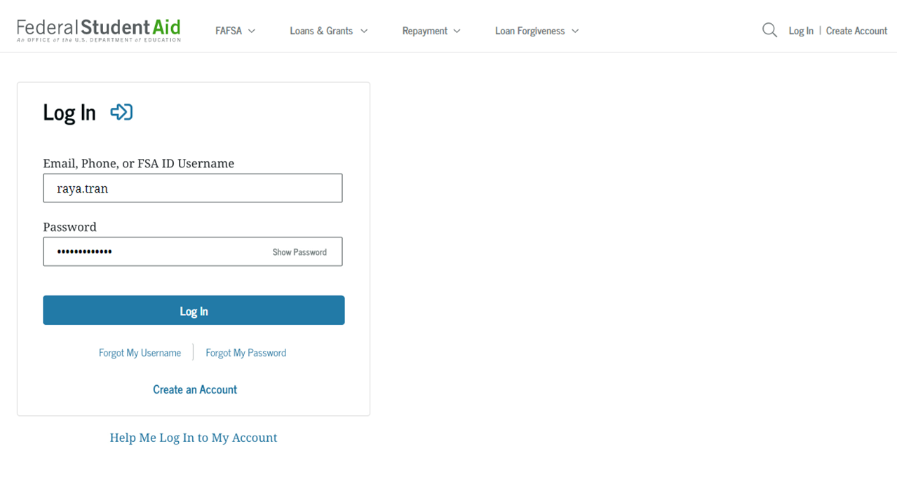
User Name and Password

Slide 21
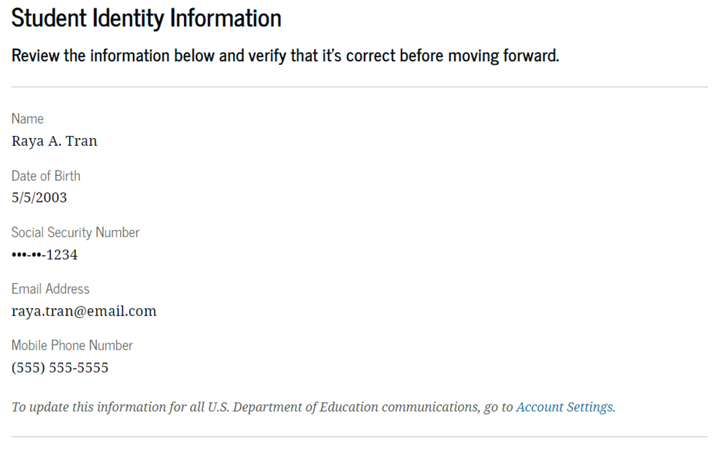
Demographic Information

Slide 22
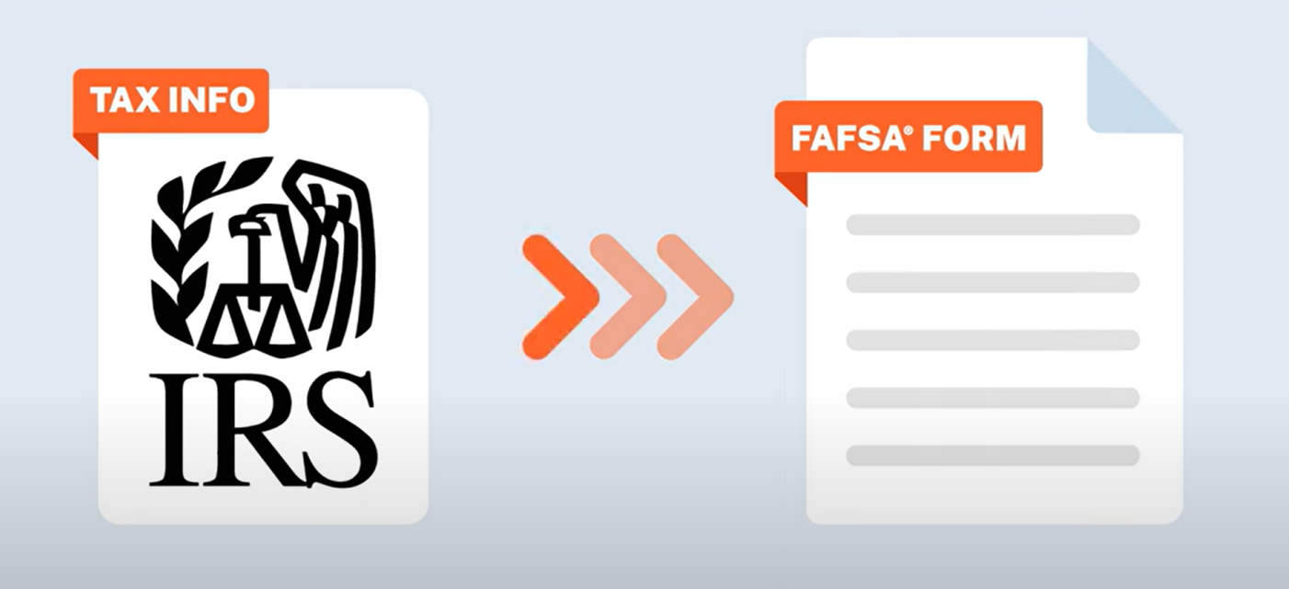
Student Financials

Slide 23
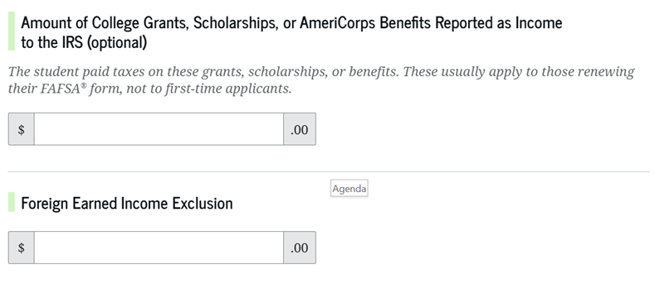
Student Financials

Slide 24
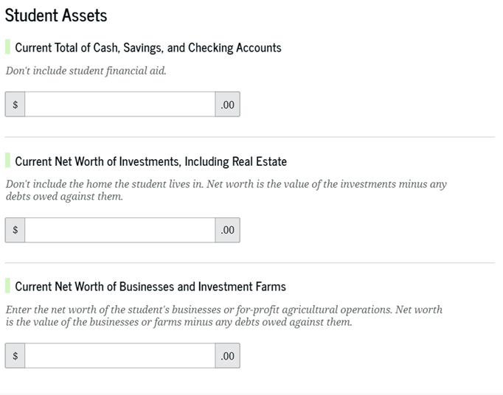
Student Financials

Slide 25
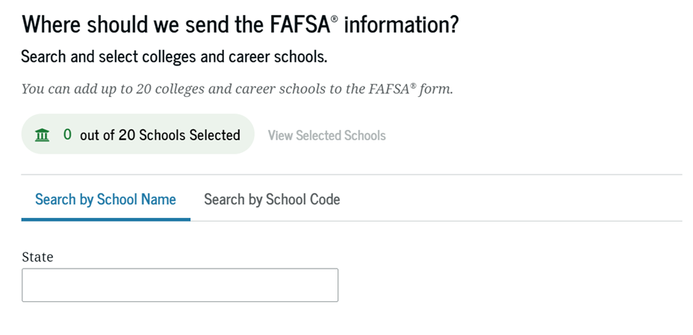
Add Colleges & Universities

Slide 26
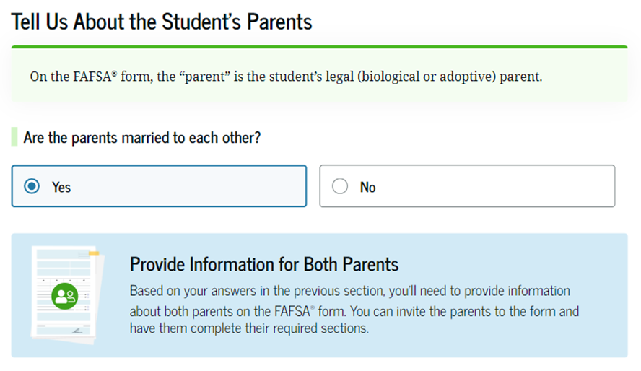
Invite Parents/Contributors

Slide 27
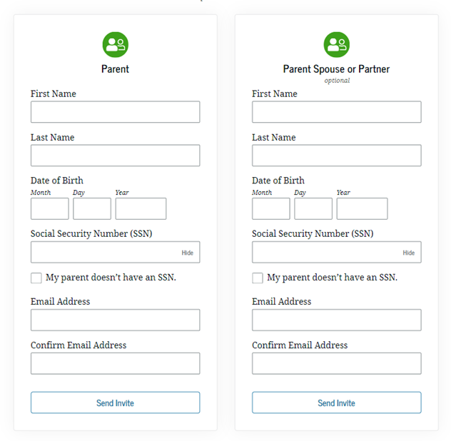
Invite Parents/Contributors

Slide 28
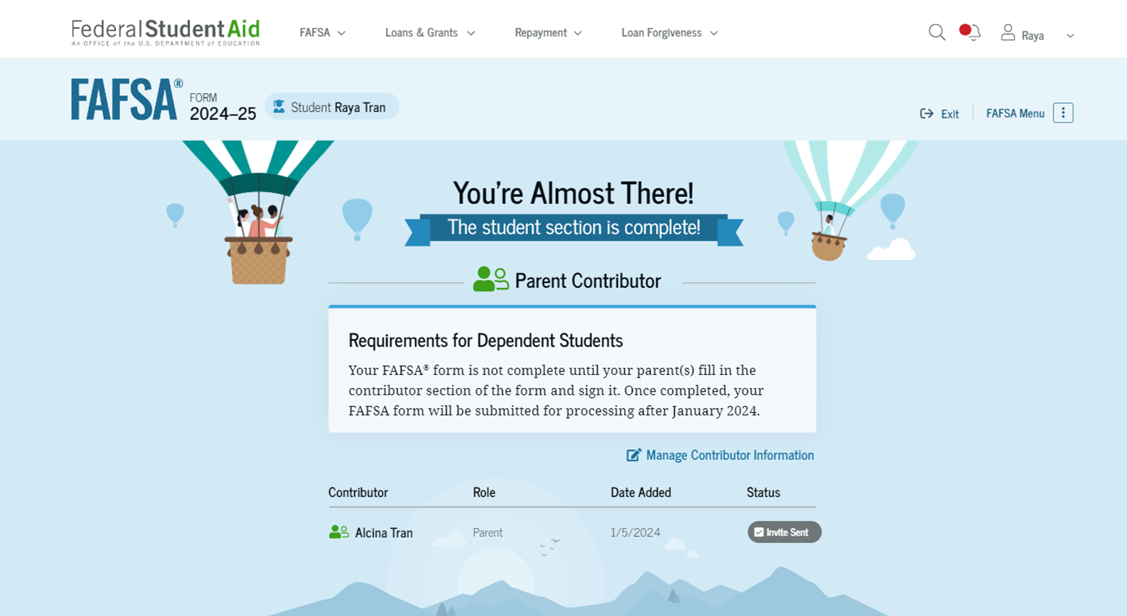
Student Signs

Slide 29
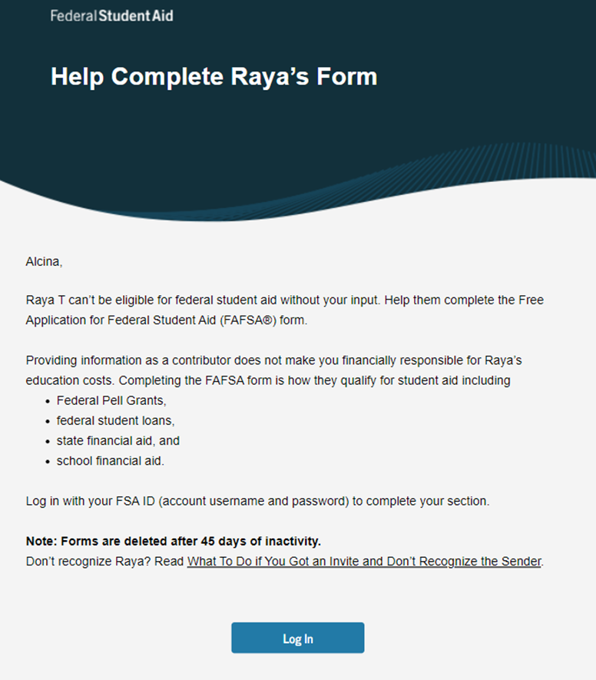
Parent Invitation Email

Slide 30
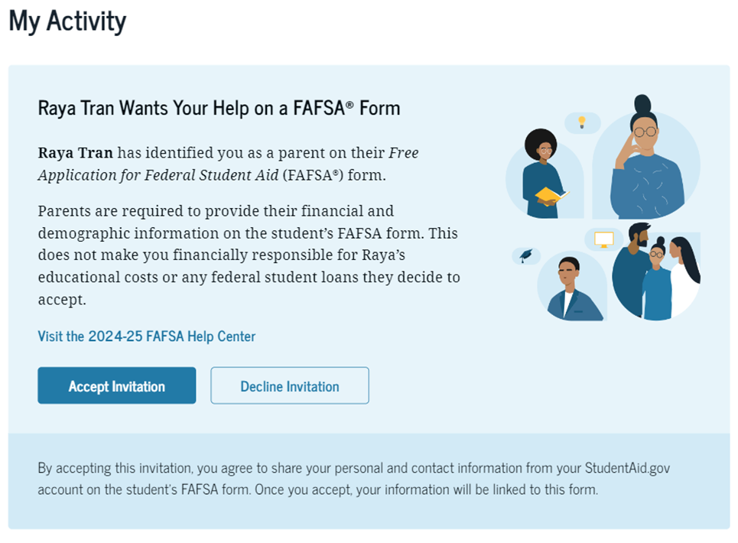
Parent FSA ID Login

Slide 31


Parent Financials

Slide 32
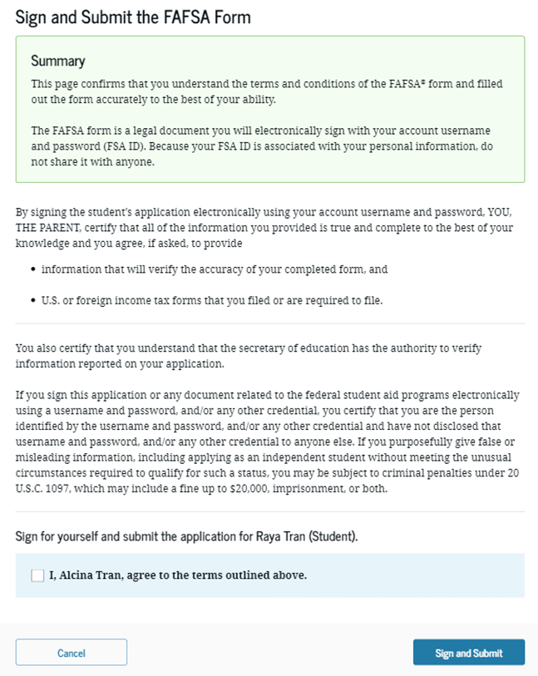
Sign & Submit

Slide 33
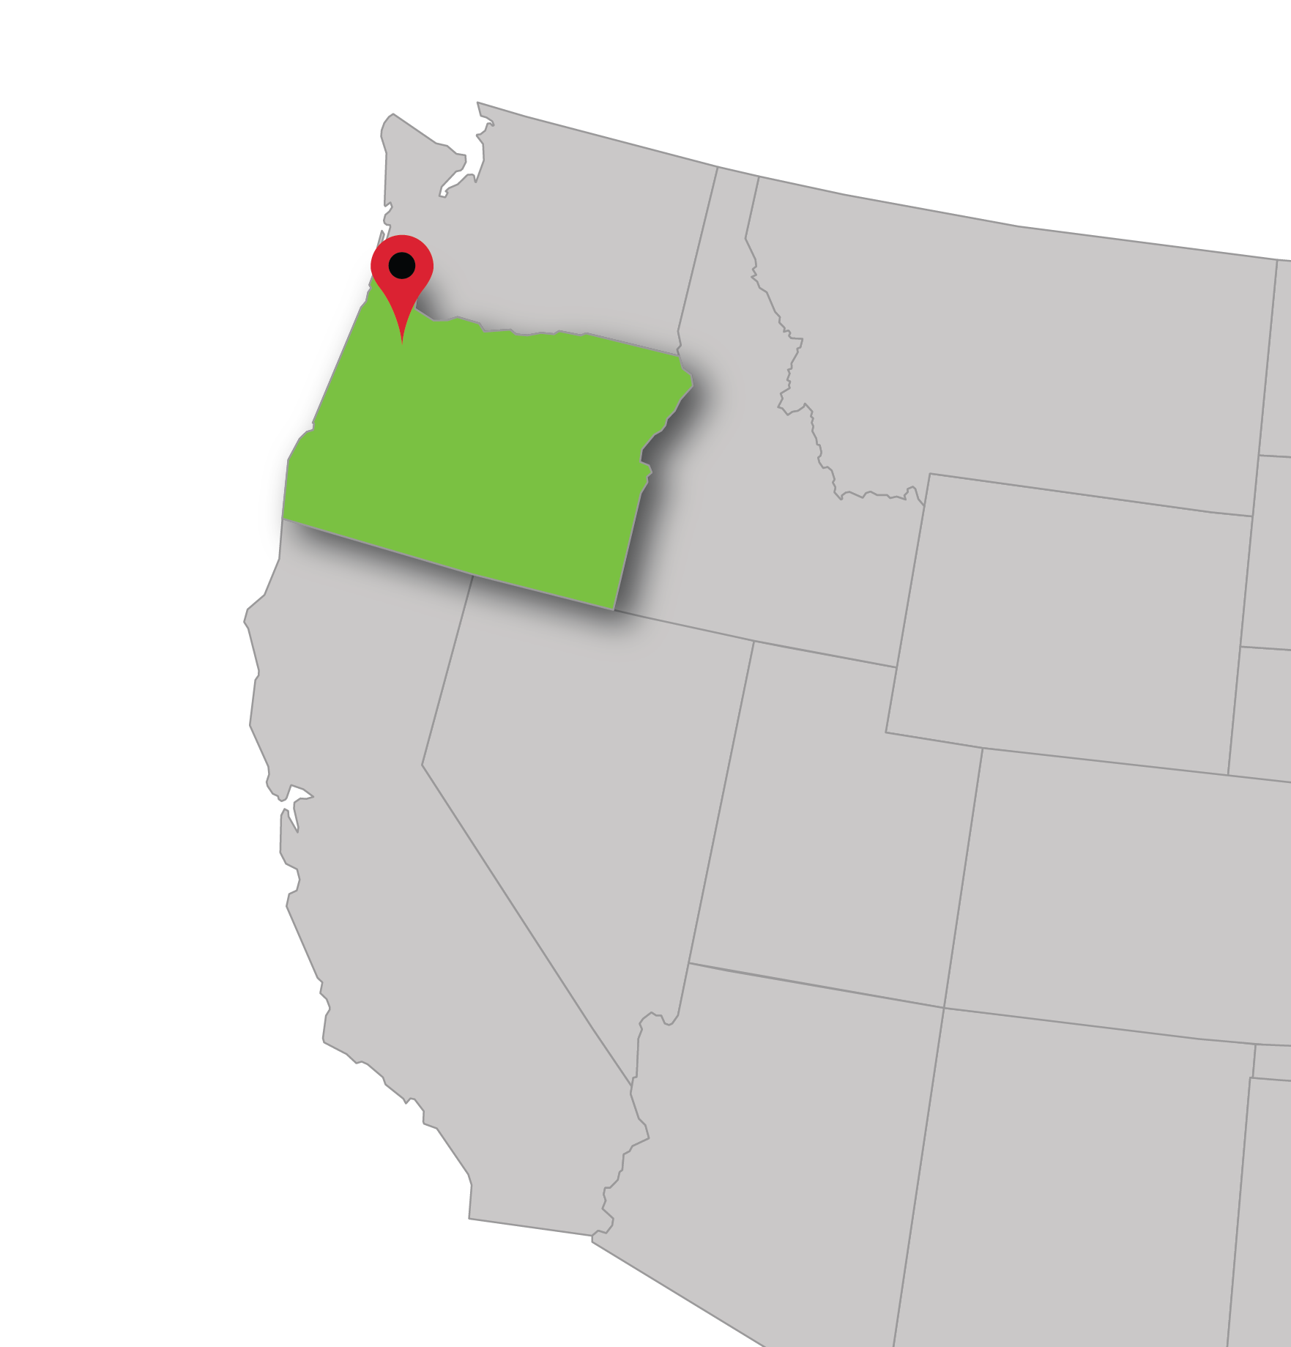
Contact Us
Oregon State University
Office of Financial Aid
Corvallis, OR
Emory Spence
Student Success and Outreach Coordinator
emory.spence@oregonstate.edu
The College Place-Oregon
Portland, OR
Jennifer Satalino
Director, The College Place
jsatalino@ecmc.org
971-722-4493
Notes:
I am always happy to lend a hand no matter where in Oregon you live! And parents, if you’ve sat through this presentation and are thinking of going to college yourself, I’m here to hep you as well.

