Slide 1

Campus Updates

Slide 2

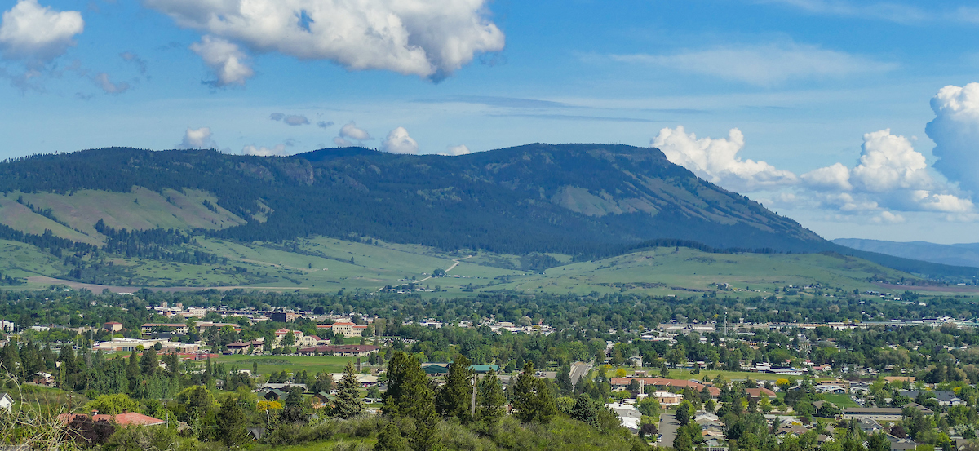

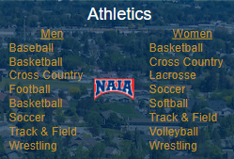
OREGON’S
RURAL
UNIVERSITY
PUBLIC UNIVERSITY WITH A PRIVATE FEEL
NEW PROGRAMS
-Agriculture Entrepreneurship
-Cyber Security (FBI+Int’l NSA Cert.)
-Data Analytics
-Special Education Licensure
-Trauma in Educational Communities
-Public Relations
ON-CAMPUS ENROLLMENT ~1,500
AVERAGE CLASS <17
STUDENT TO FACULTY RATIO 13:1
+ LACROSSE (W)
+ BASEBALL
*W. Volleyball #1!*

Slide 3
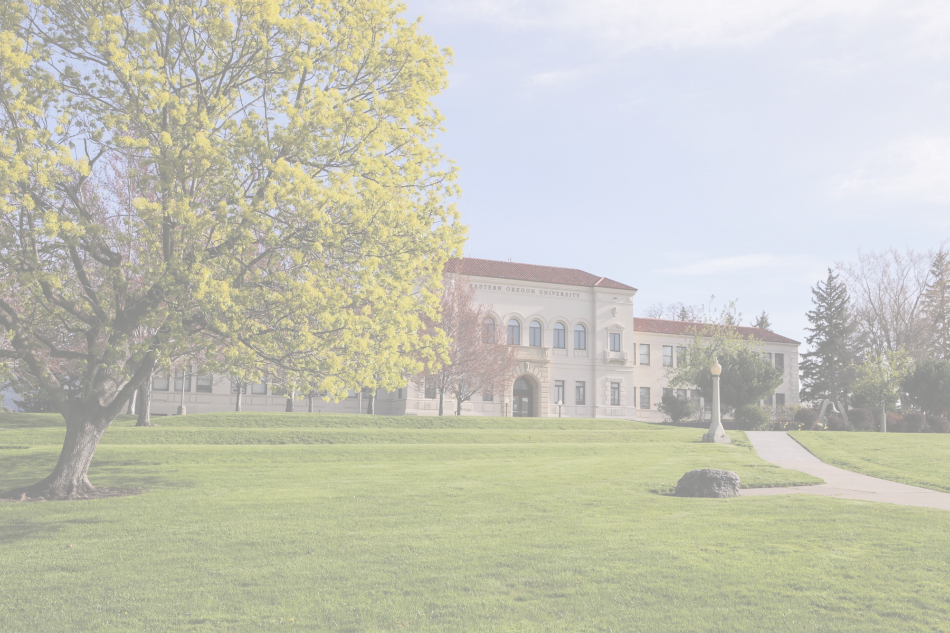
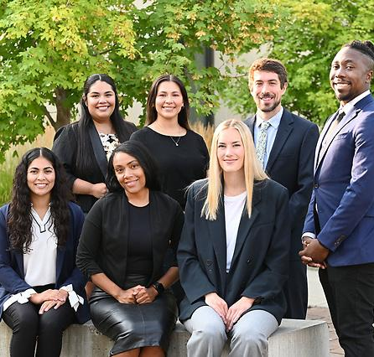
APPLY
Annual Cost
-eou.edu/apply
-Common App
-Unofficial Transcripts
-$50 Fee (Deferrable)
-No ACT/SAT
-No Essay
-Tuition and fees $11,000
-WUE
-WA & ID pay OR rate
CAMPUS UPDATES
DEADLINES
VISIT
-EOU.EDU/VISIT
-Daily Campus Visits
-MON-FRI 9:30am & 1:30pm
-PREVIEW DAYS
-Oct. 18, Mar. 14 & Apr. 11
-Funded School Group Visits
-Leadership Changes
-Increased Enrollment 23% freshmen (18% overall)
-Indoor Track & Field House
-$5.5 million in Theater Renovations
-Industry Standard Theater Renovations
-Automatic Preview Day Scholarships
-Rolling Application
-Fall 2025 Scholarships Open Nov. 1 – Mar. 1

Slide 4
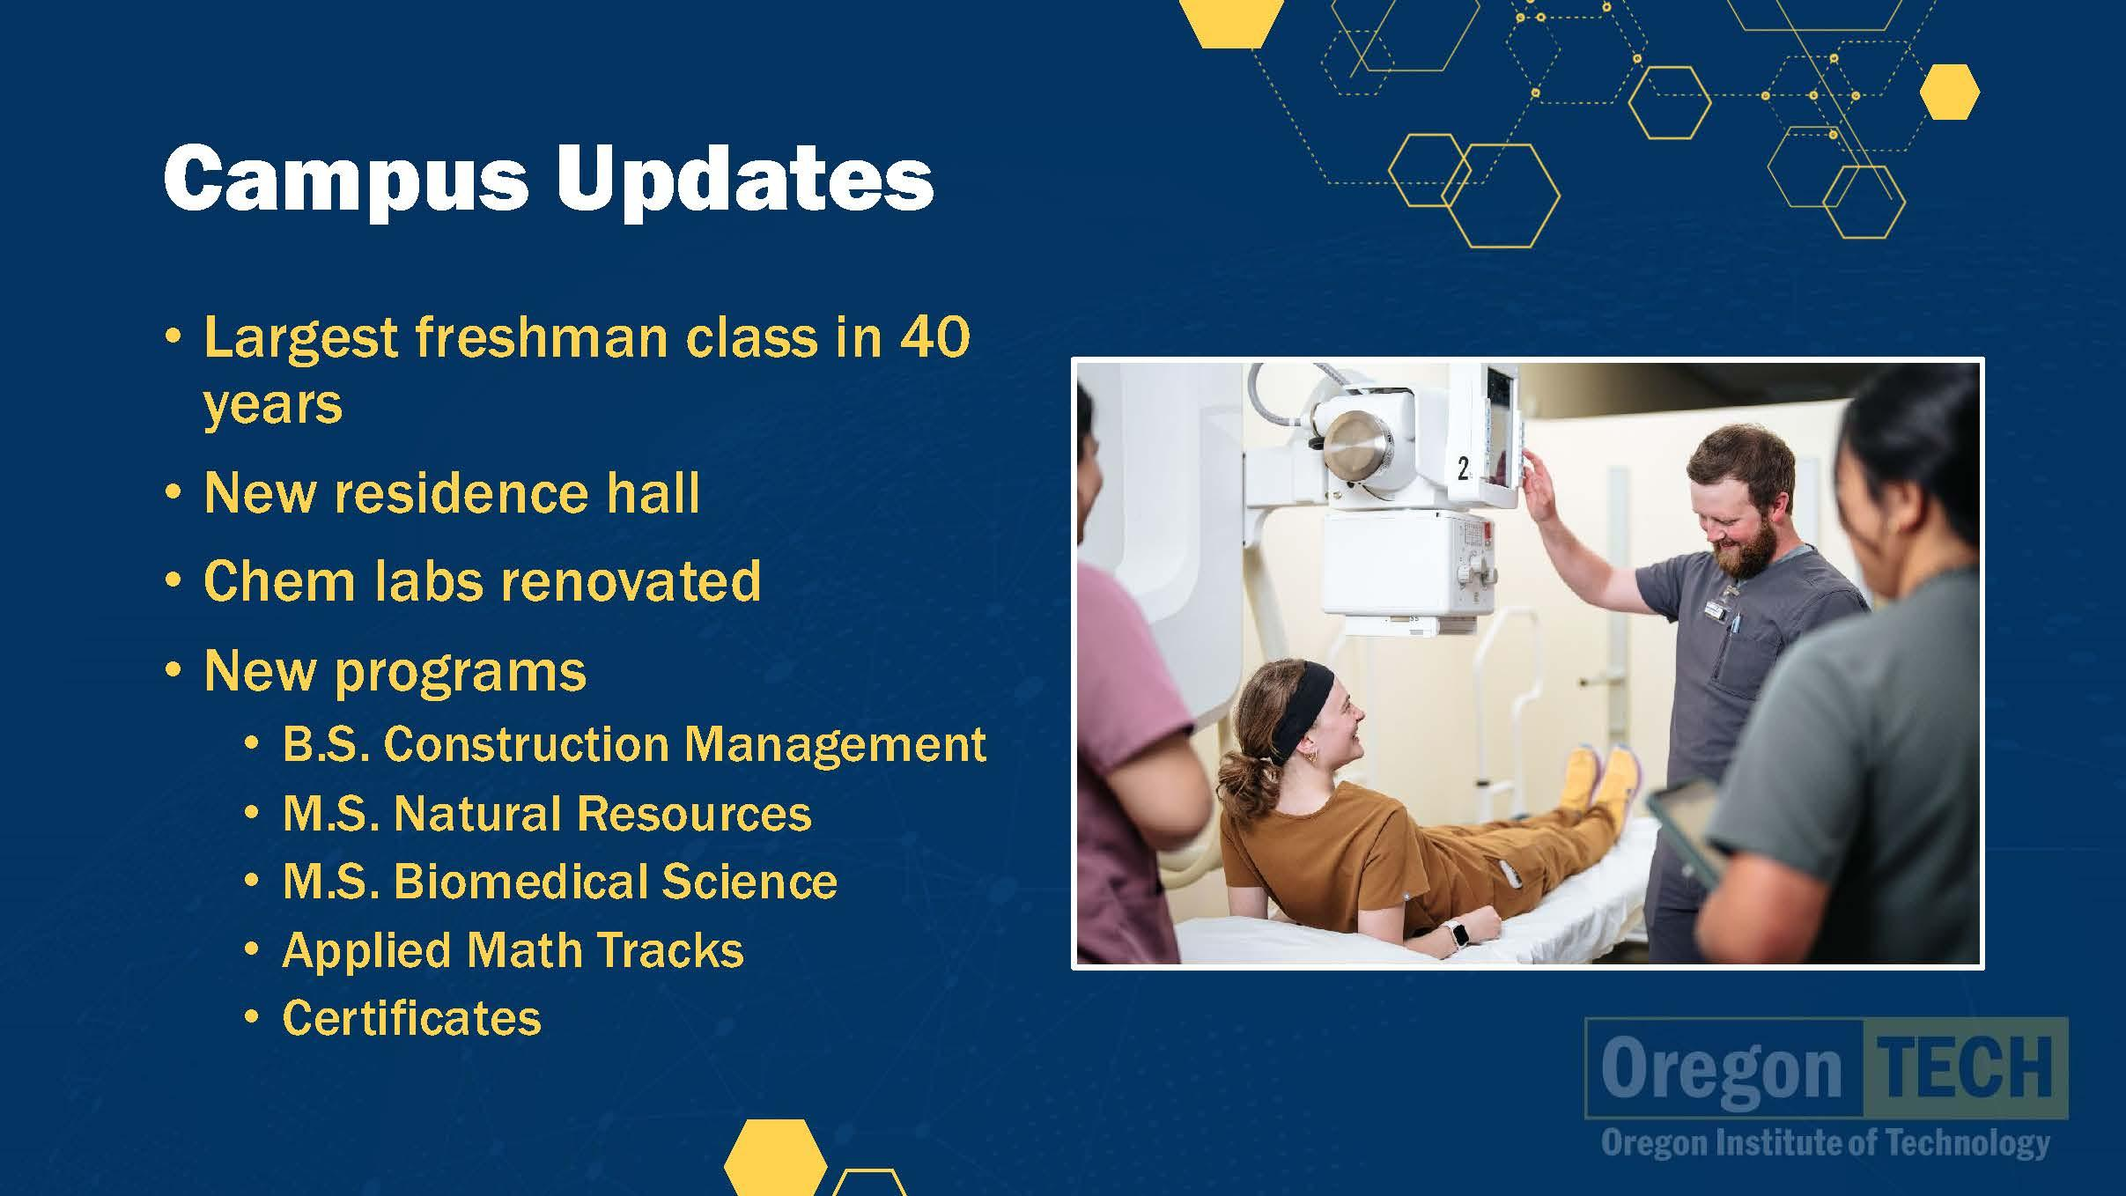

Slide 5
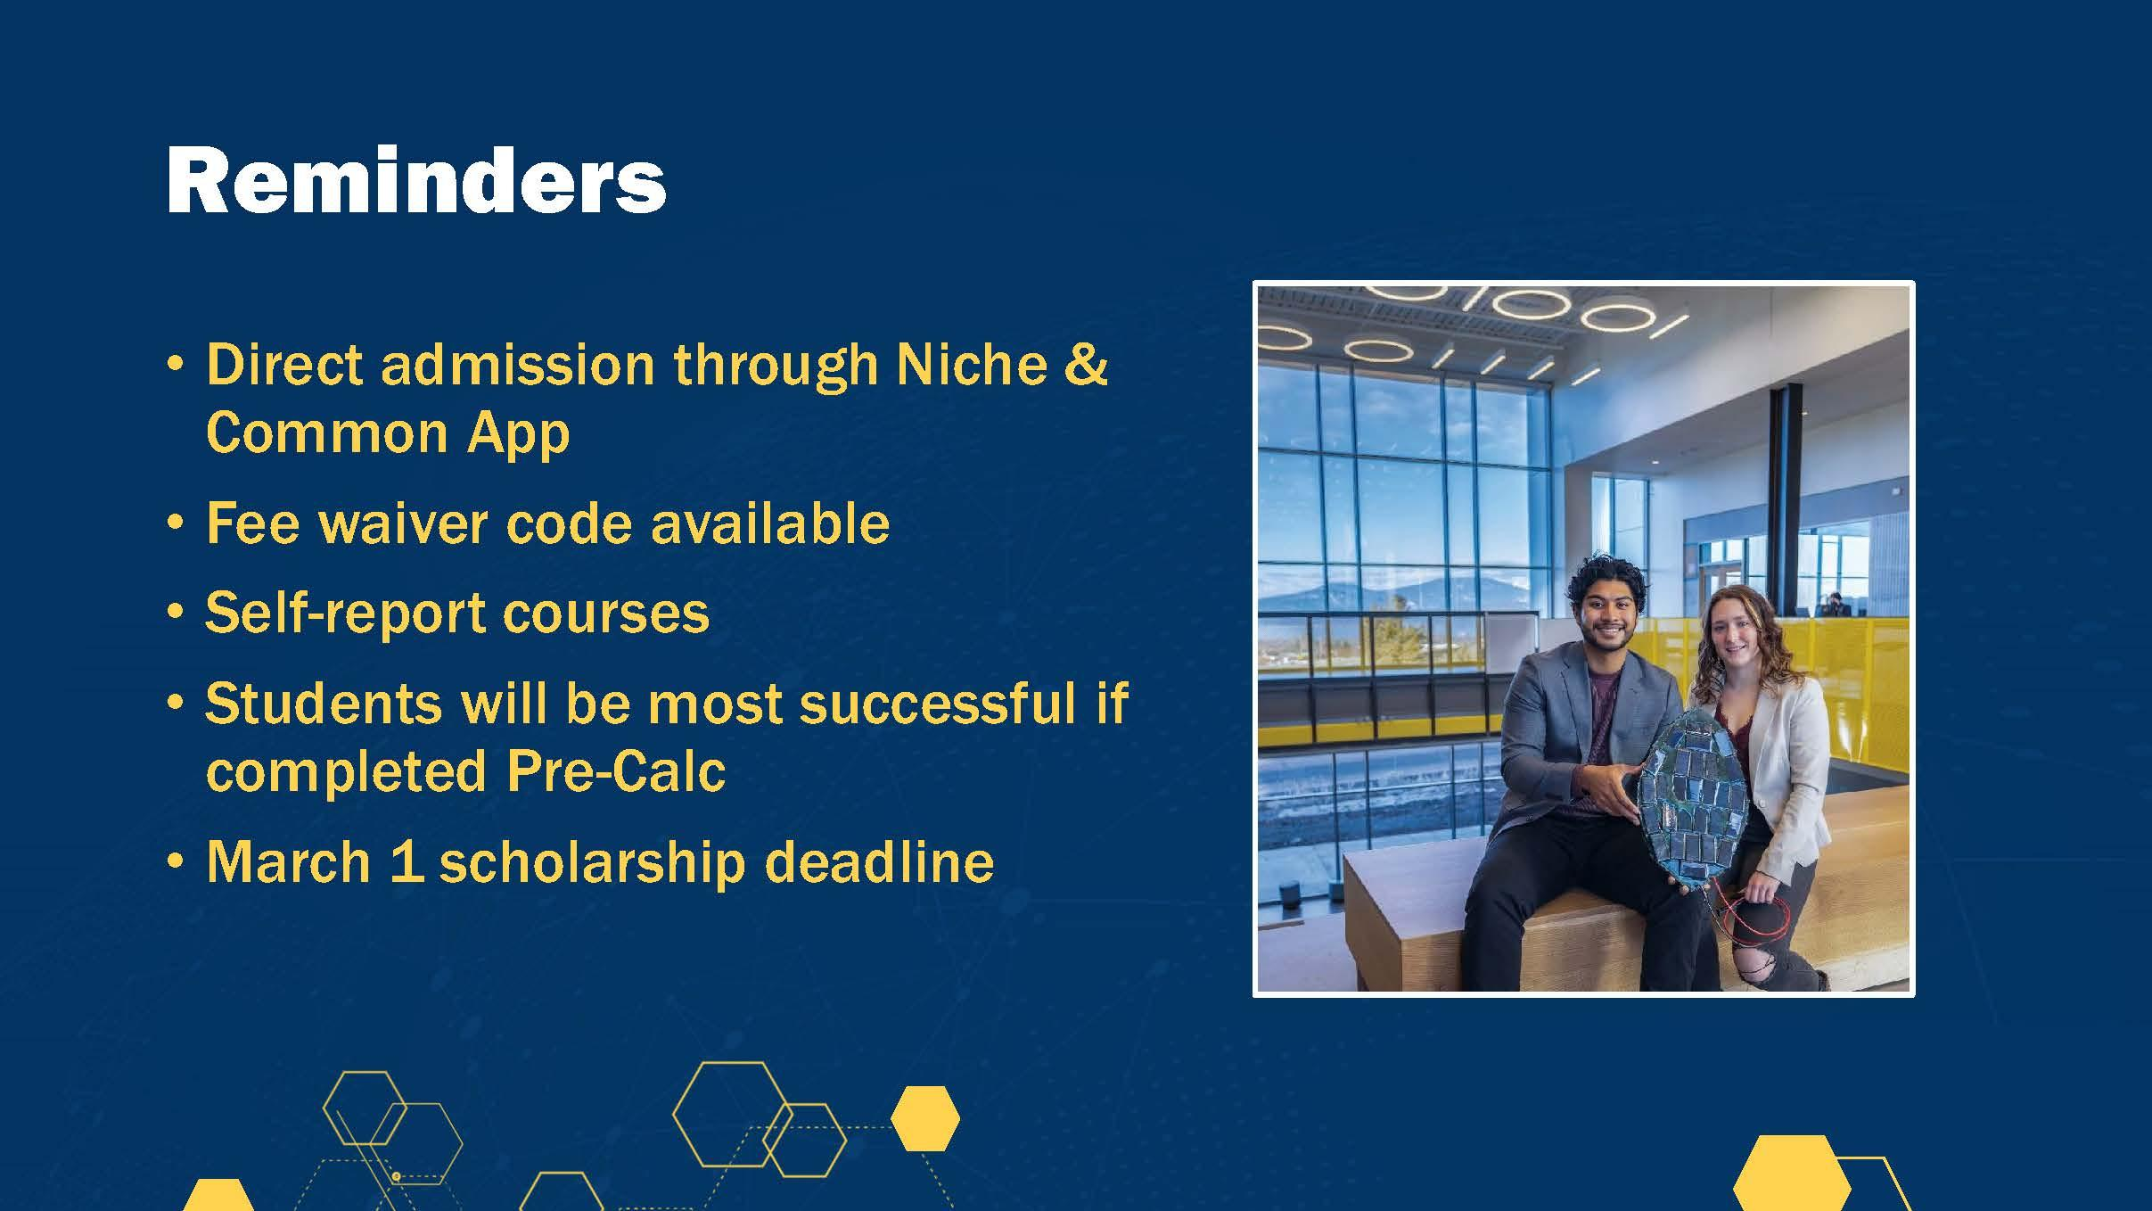

Slide 6


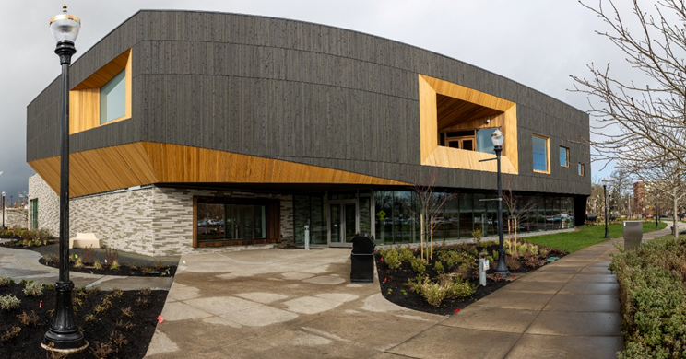


CAMPUS UPDATES
Overall OSU enrollment of 38,000 students, including 4,600 new freshmen and 1,200 new transfers in Corvallis
$491 million in research funding in 2023-24
Patricia Valian Reser Center for Creative Arts (PRAx) now open
Jen-Hsun Huang and Lori Mills Huang Collaborative Innovation Center is under construction (open 2026)
New housing project underway at Hatfield Marine Science Complex is underway
Additional housing project plans for Corvallis coming soon
New minor in Criminology

Slide 7
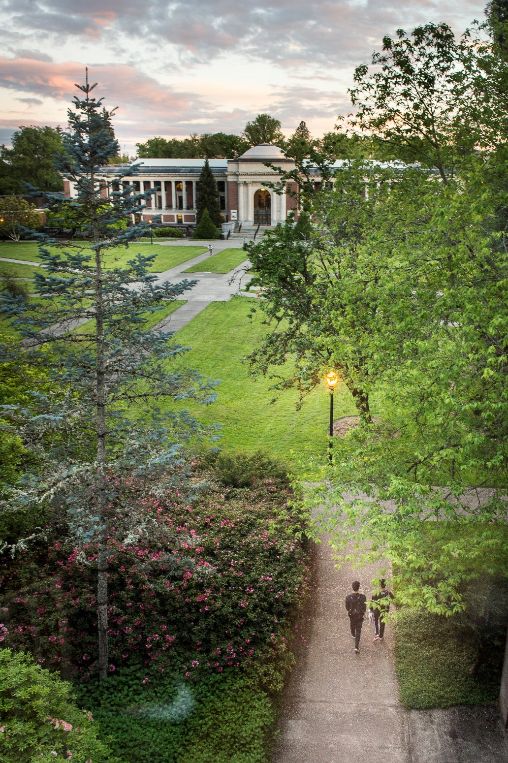

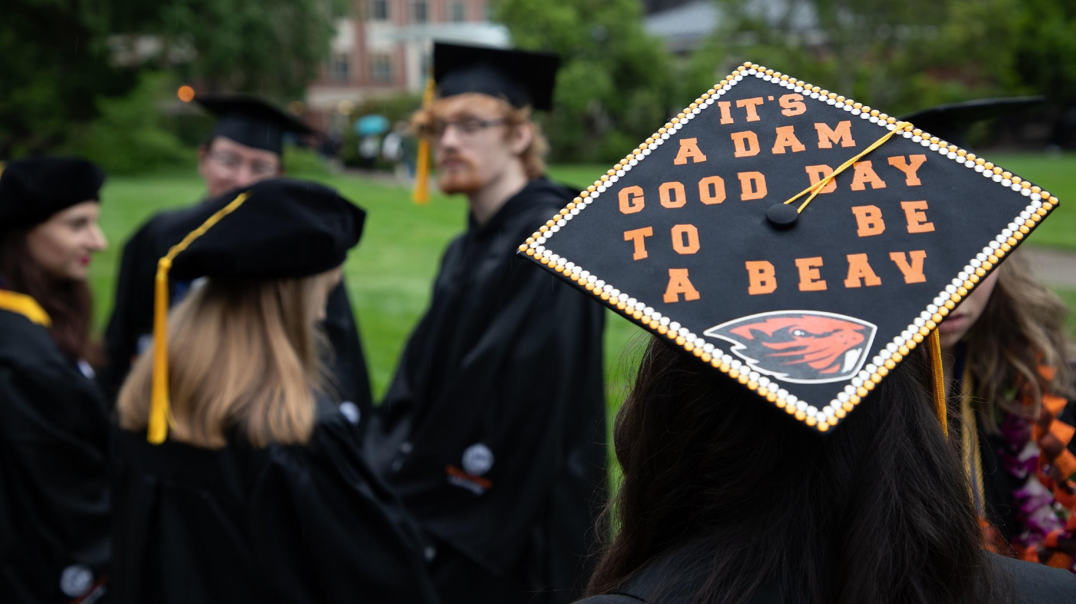
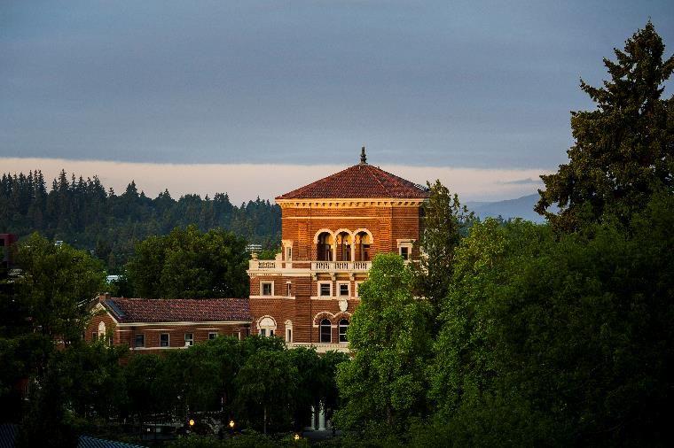
REMINDERS
Applicants can upload unofficial transcript when applying
Applicants must be “Calc-Ready” to be admitted directly to Engineering
Last year new first time freshman applications closed on February 2nd and some students were waitlisted
Finley Scholarships will begin awarding for admitted students in mid-December
Join us for our monthly Counselor Huddle (virtual). Next Huddle is November 14th.

Slide 8
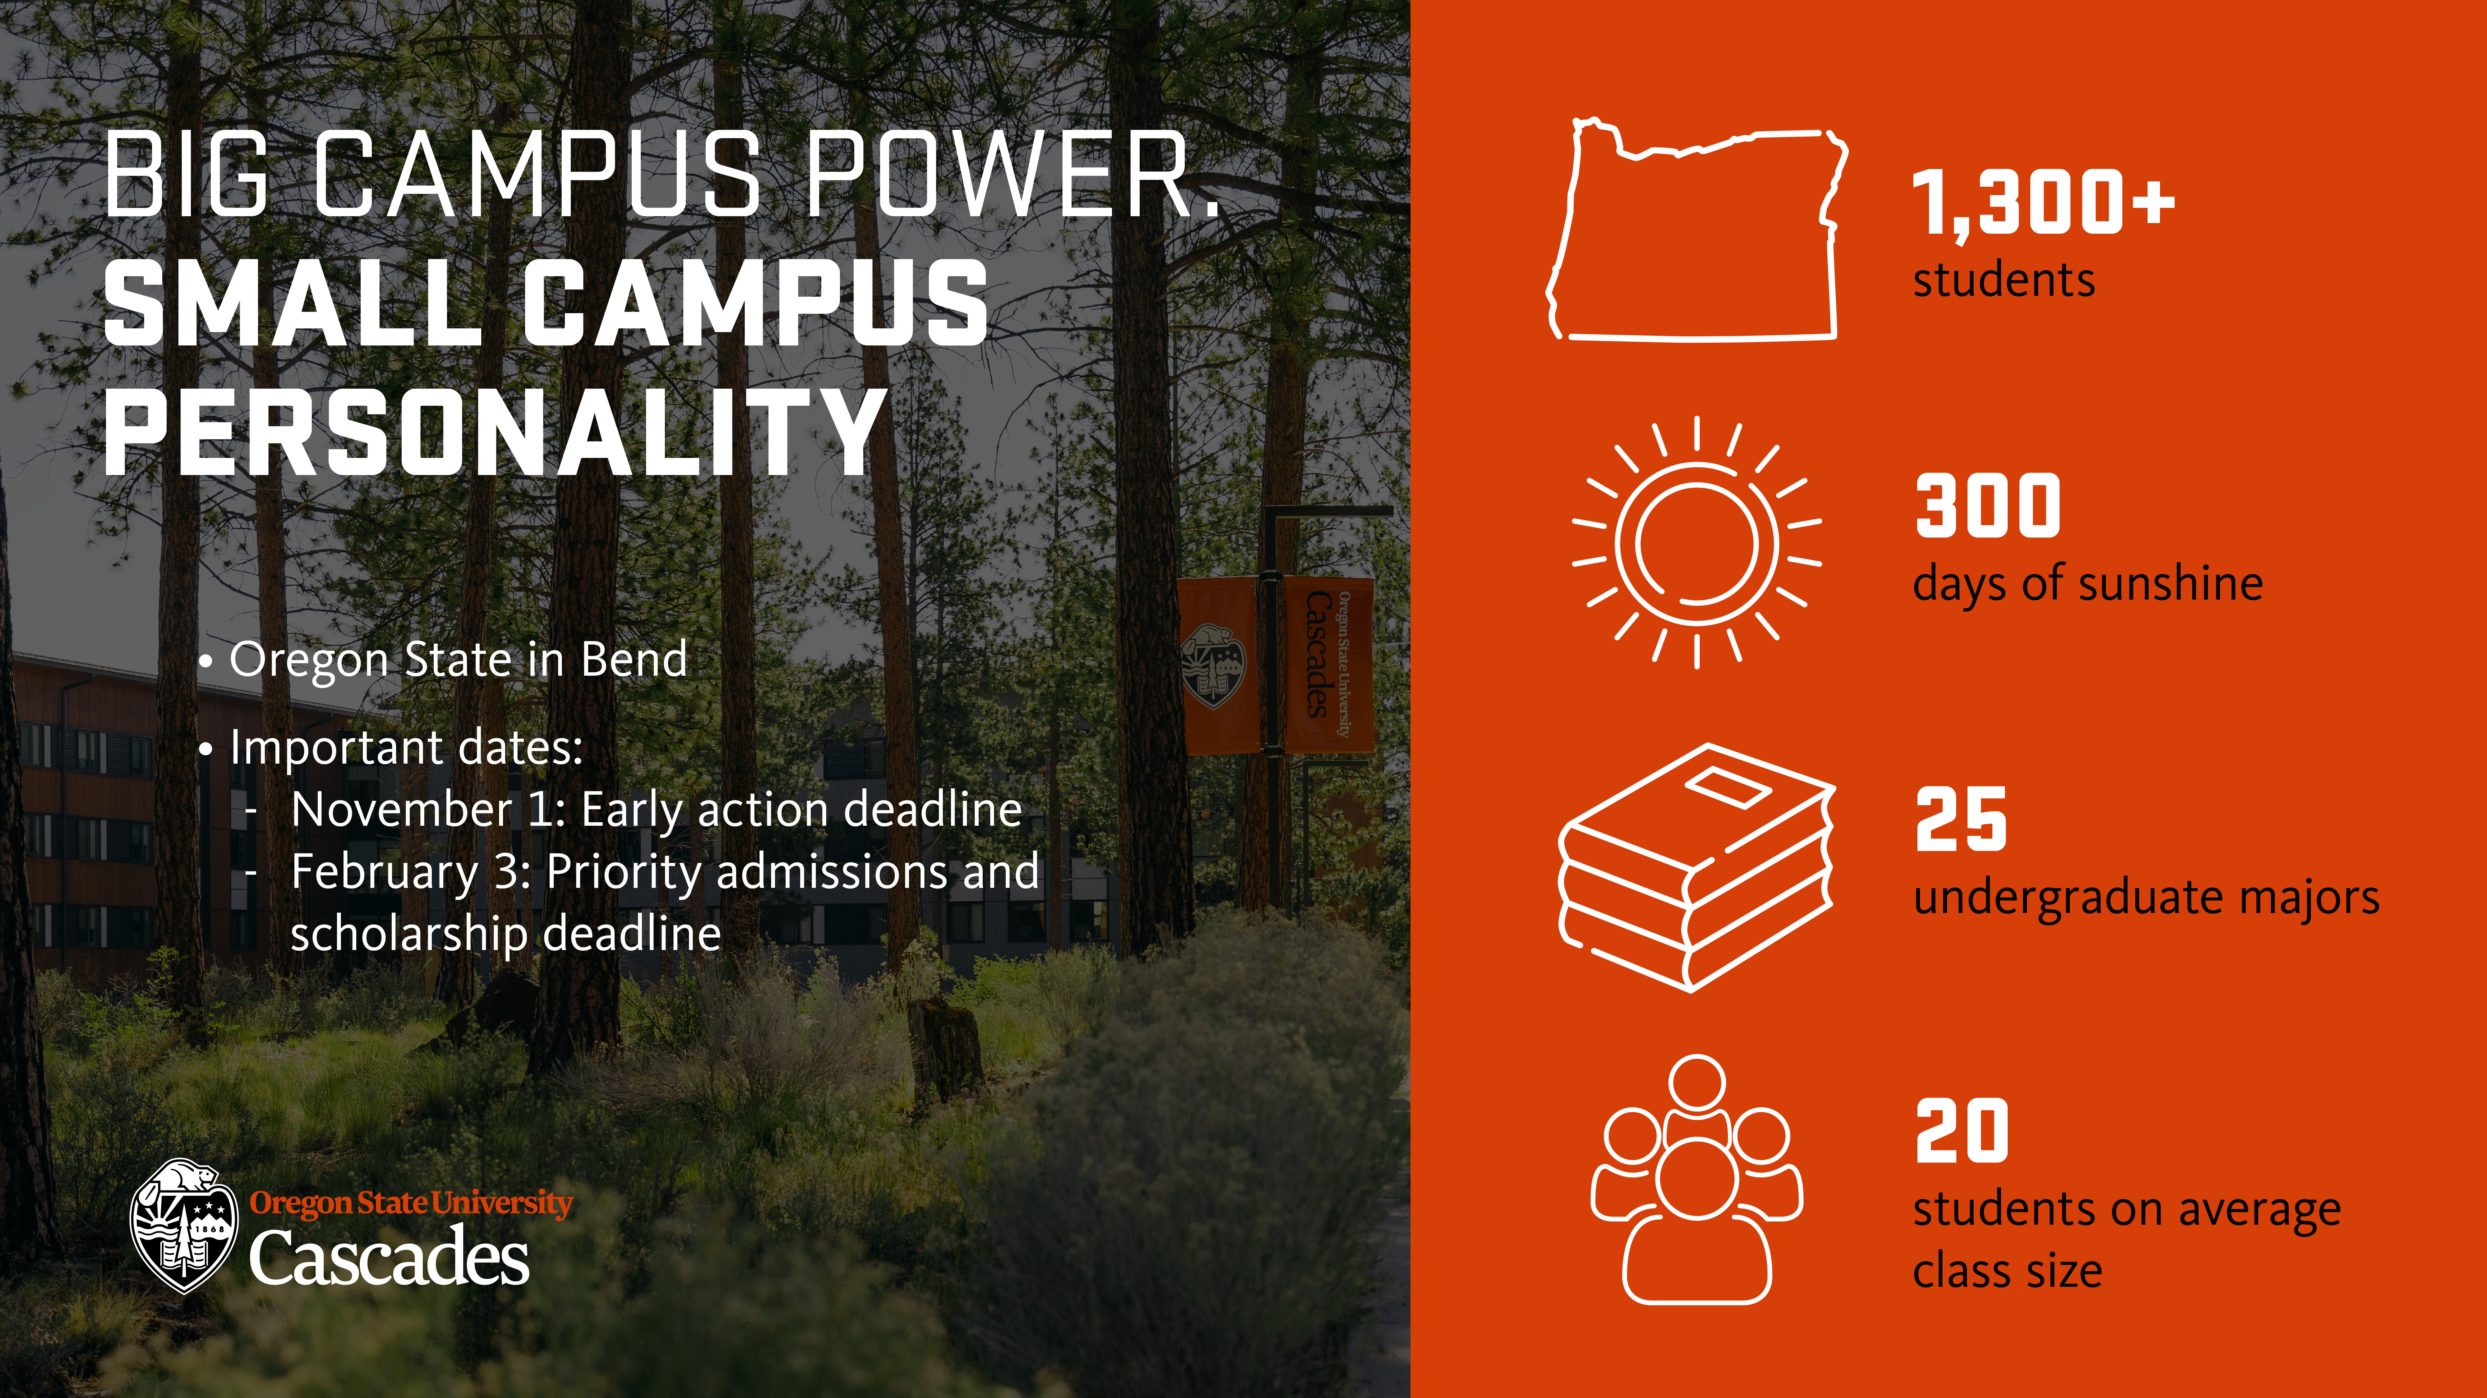
Notes:
New outdoor ranking

Slide 9
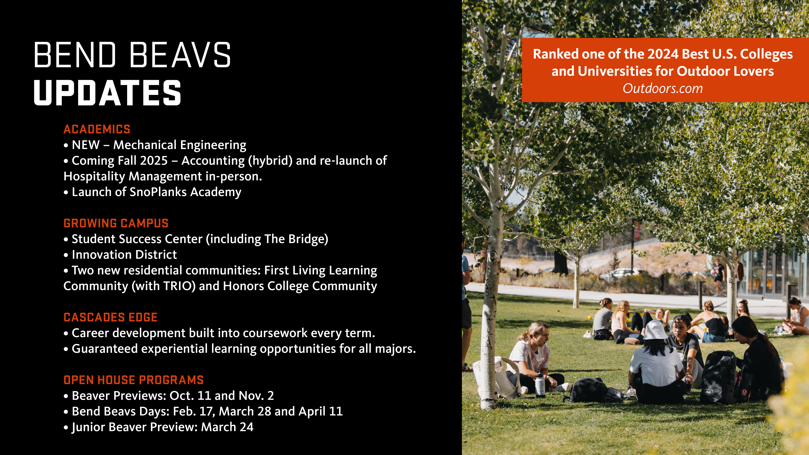
Notes:
Next fall will have hybrid accounting and revamped HM
New living learning communities

Slide 10
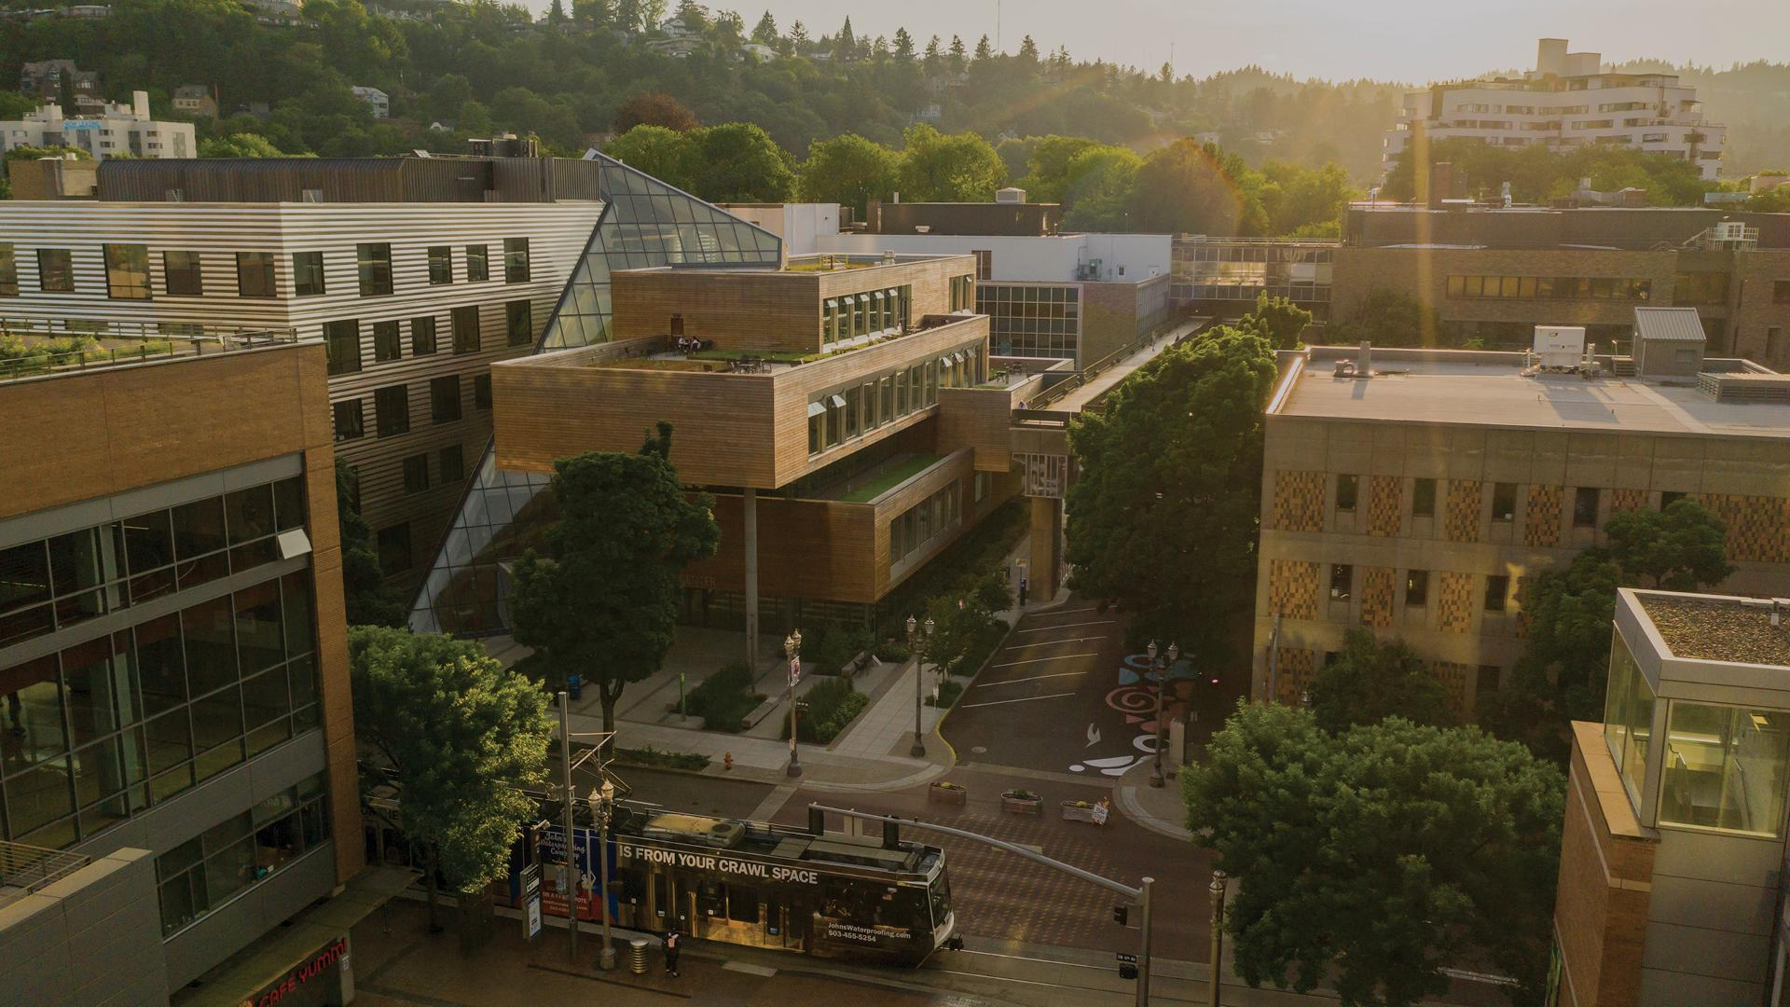

Enrollment Summary & Campus Updates
Top Majors for Enrolling Class of Fall 2024:
Psychology, Computer Science, Biology, Public Health Studies, Social Work, Accounting, Marketing, Criminology & Criminal Justice, Engineering, Graphic Design, Architecture
New Academic Programs:
Art & Design, Elementary Education, Social Justice & the Arts
Application Deadlines:
January 1 - Honors Priority
August 1 - Tuition Free Degree
Top Employers:
Intel, OHSU, Nike, Providence Health, Kaiser Permanente,
Multnomah County, City of Portland, Daimler, Amazon, Apple
Notes:
Personal Intro Comments
New Student Enrollment Update
New enrollment was down about 5% this fall at Portland State, or 180 or so undergraduate students. Surprisingly we were slightly up in non-resident enrollment so the entirety of our decrease is with resident students, or Oregonians.
The top majors on the screen in front of you reflect the most popular majors across the entirety of our incoming class. So not necessarily our largest majors at PSU, but more of a reflection of what’s most popular with our incoming class.
Summer Scholars Program Update
Reminder of what Summer Scholars is… and that it’s officially required for qualifying first-year students as of this fall.
This year, we welcomed over 340 first-year students and 230 transfer students who opted into the program. This cohort is notably more diverse than our overall incoming class and as of this week of the 340 first-year students for whom this program less than 5 have not satisfied our mandatory requirements.
Facts About PSU Student Body
In total at PSU among the 16,000 or so total undergraduates about half (or 49%) of our students identify as first-generation but 78% of our students identify as at least Pell eligible, First Generation, and/or non-White.
AANAPISI Designation
That said, it’s likely no surprise that PSU was designated a minority serving institution (MSI) last year and we’ve since begun to receive federal funding as an AANAPISI, or Asian American Native American Pacific Islander Serving Institution. Over summer we hired our first Pacific Islander Student Retention Coordinator, Cinta, who is from American Samoa and whose primary purpose on campus to ensure the academic success of students who are attending PSU and who identify as Pacific Islander.
New Academic Programs (provide a very brief description of each new program)
Art & Design Major
Elementary Education Major
Social Justice & the Arts Major
Math Pathways
We’ve seen very few new math courses being taken by students across the state, most of the new pathway math courses we’re seeing are intuitively named Data Science, nothing out of the box yet. We continue to urge schools that are creating new math pathway courses to communicate their creation to us, or at the very least, make sure that the courses are updated in your course catalogs such that they reflect the pathway in which they’re located.

Slide 11
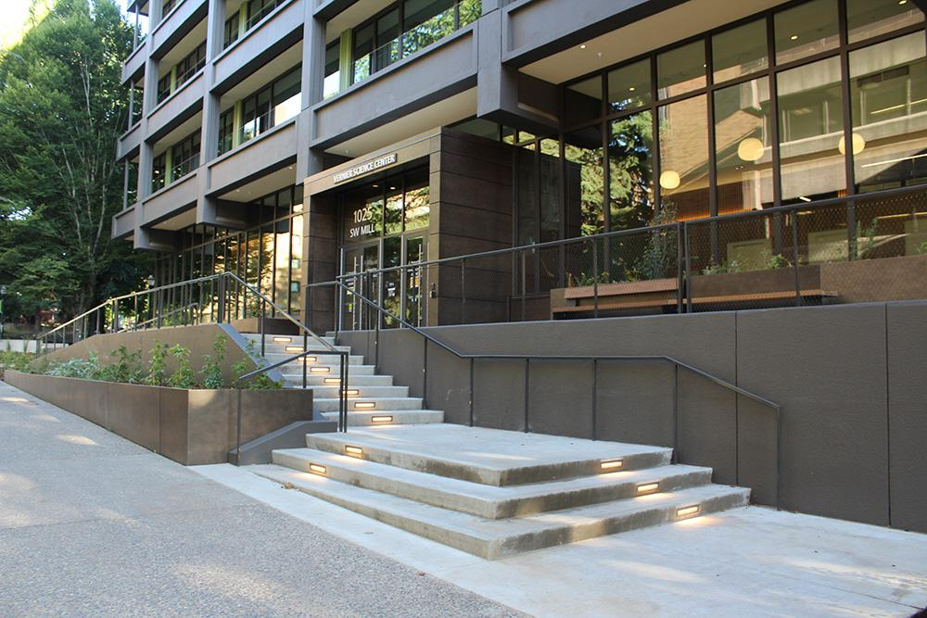
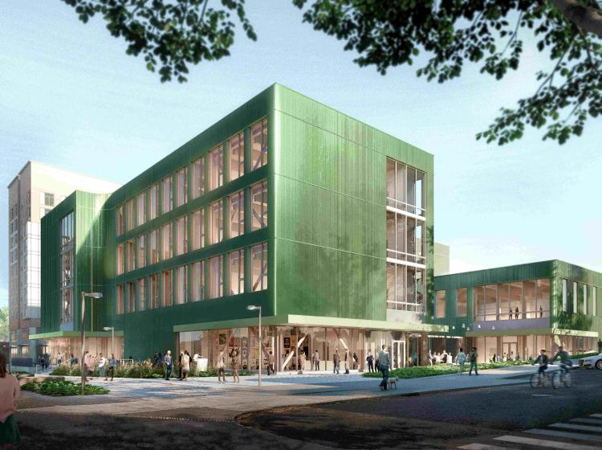
Enrollment Summary & Campus Updates
Vernier Science Center Complete!
Wayfinder Counselor Tour
April 30 - May 2, inquire online today!
Group Visit Offerings Expanded
Now available M, T, Th, and Fri @ 10 AM or 1 PM
College of Art + Design Construction Continues…
Expected completion in 2026
Notes:
Vernier Science Center
Completed on time this past summer, the Vernier Science Center is now home to many of our hard sciences as well as our Indigenous Nations Studies Department. This building was designed in part by PSU architecture students and gathered input from BIPOC staff, students and faculty as they worked to design a space that houses our STEM support programs, as well as culturally affirming spaces such as a kitchen, gathering spaces and a library to support the expansion of indigenous and cultural knowledge-centered curriculum.
Native Student Remission Programs
Within that same vein I’d also add that our MCECS is home to one of only two Native American Engineering Department Chairs in the country, and the only Native American dean of an engineering college: native student resource sheet.
In addition to existing Native student scholarship and tuition rates, PSU will begin to offer scholarships to native students who are Oregon residents and who are members of one of the 574 federally recognized tribes that do not have ties to Oregon. (confirm accuracy of this updated doc).
Wayfinder Counselor Tour
Dates are set for spring term, briefly explain the program to the audience and mention that the program includes both Portland State University and Oregon and Health Sciences University.
Overnight program, travel to campus is reimbursed, meals and lodging are covered during the program.
Group Visits Offerings Expanded
Portland State University offers group tours for groups of 15 - 60 prospective students (grades 9 to 12) and their chaperones in a limited capacity. Group visits are offered on Monday, Tuesday, Thursday, and Friday at either 10:00 AM or 1:00 PM. The visit includes a 30-minute information session and a 75-minute walking tour led by a Student Ambassador. Reservations are required and a visit must be requested at least three weeks in advance of your preferred date and time so that we may offer you the best possible visit experience.
College of Art + Design Construction Reminder
This is a reminder more than anything, to those of you who were in attendance last year you heard our excitement over the College of Art + Design construction because it will bring all of our art and design majors together into one thoughtful space. This is just a reminder that construction continues to progress and we remain on schedule for this exciting space.
Consider Finishing Comments with PSU’s Role in Portland Revitalization…
Tie this back to the Wayfinder Counselor Tour as an opportunity to see the state of Portland if anyone’s not visited recently.
Comments about the performing arts center?
We should know by 10/10 from the city of Portland. Check in with Chuck to see if there’s an update prior to presenting.

Slide 12


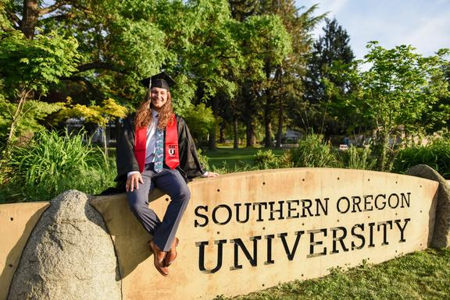


140+ PROGRAMS
5,100 STUDENTS
SOUTHERN OREGON
UNIVERSITY
IMPORTANT DATES
March 15 >> Southern Oregon Scholarship Application (SOSA) deadline
May 15 >> Degree in Three priority application date
Rolling Admissions >>
SOU Application & Honors College

Slide 13

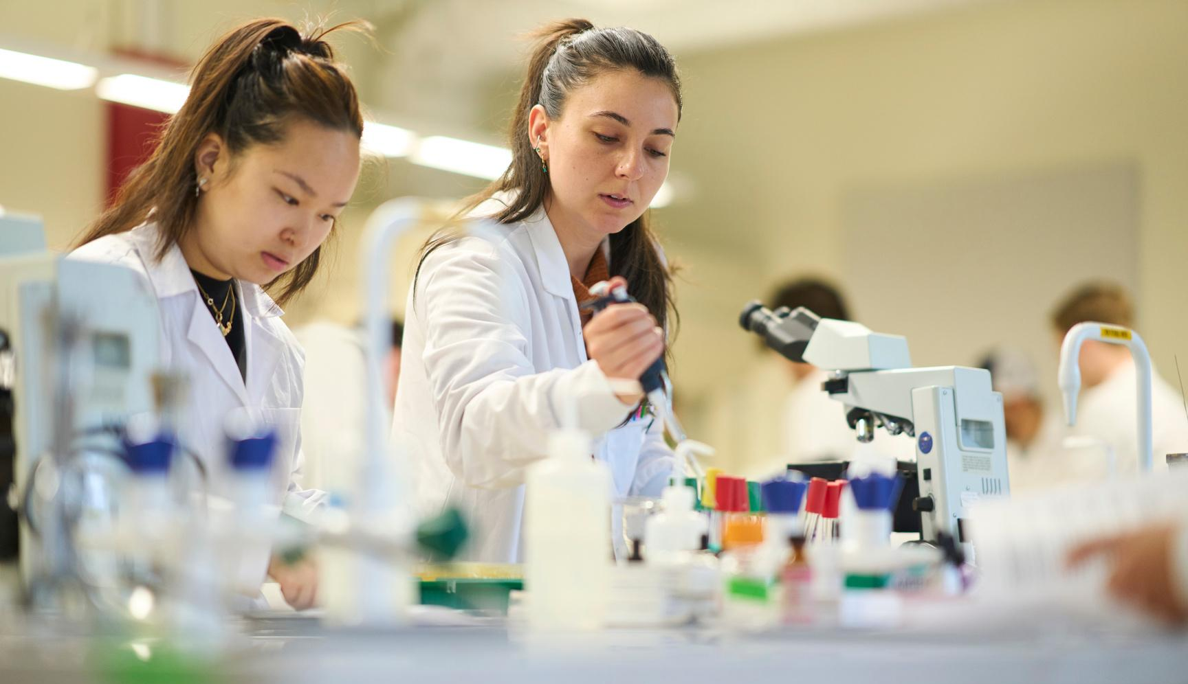
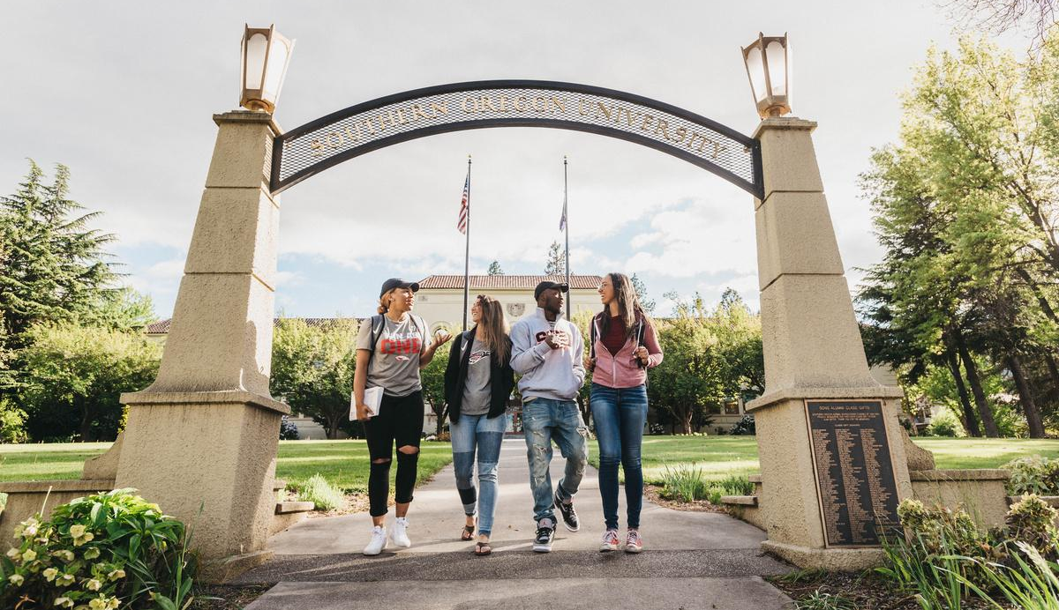
UPDATES
CAMPUS
30 Best Film Schools in US / Canada (Moviemaker Magazine)
Coziest College Town (thetravel.com)
3rd $1 Million state grant for solar arrays
Doubling Honors College Cohort
Lithia / Driveway Scholars
New Majors
  Digital Cinema Production Arts BFA
  Ecology and Conservation
  Biomedical Science
Preview Day - Nov 15 / Feb 7 / April 11

Slide 14
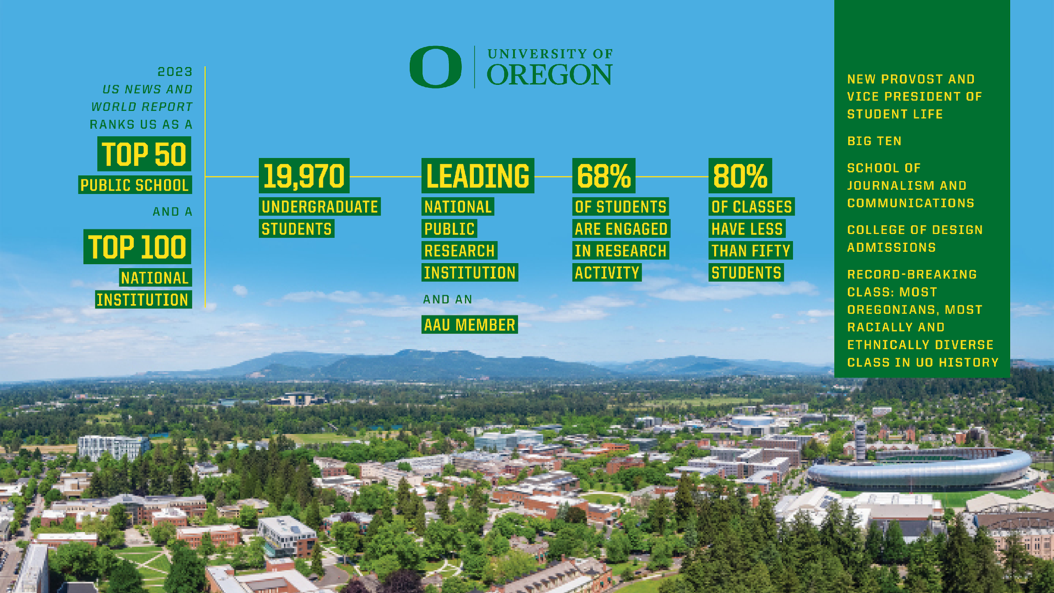

Slide 15
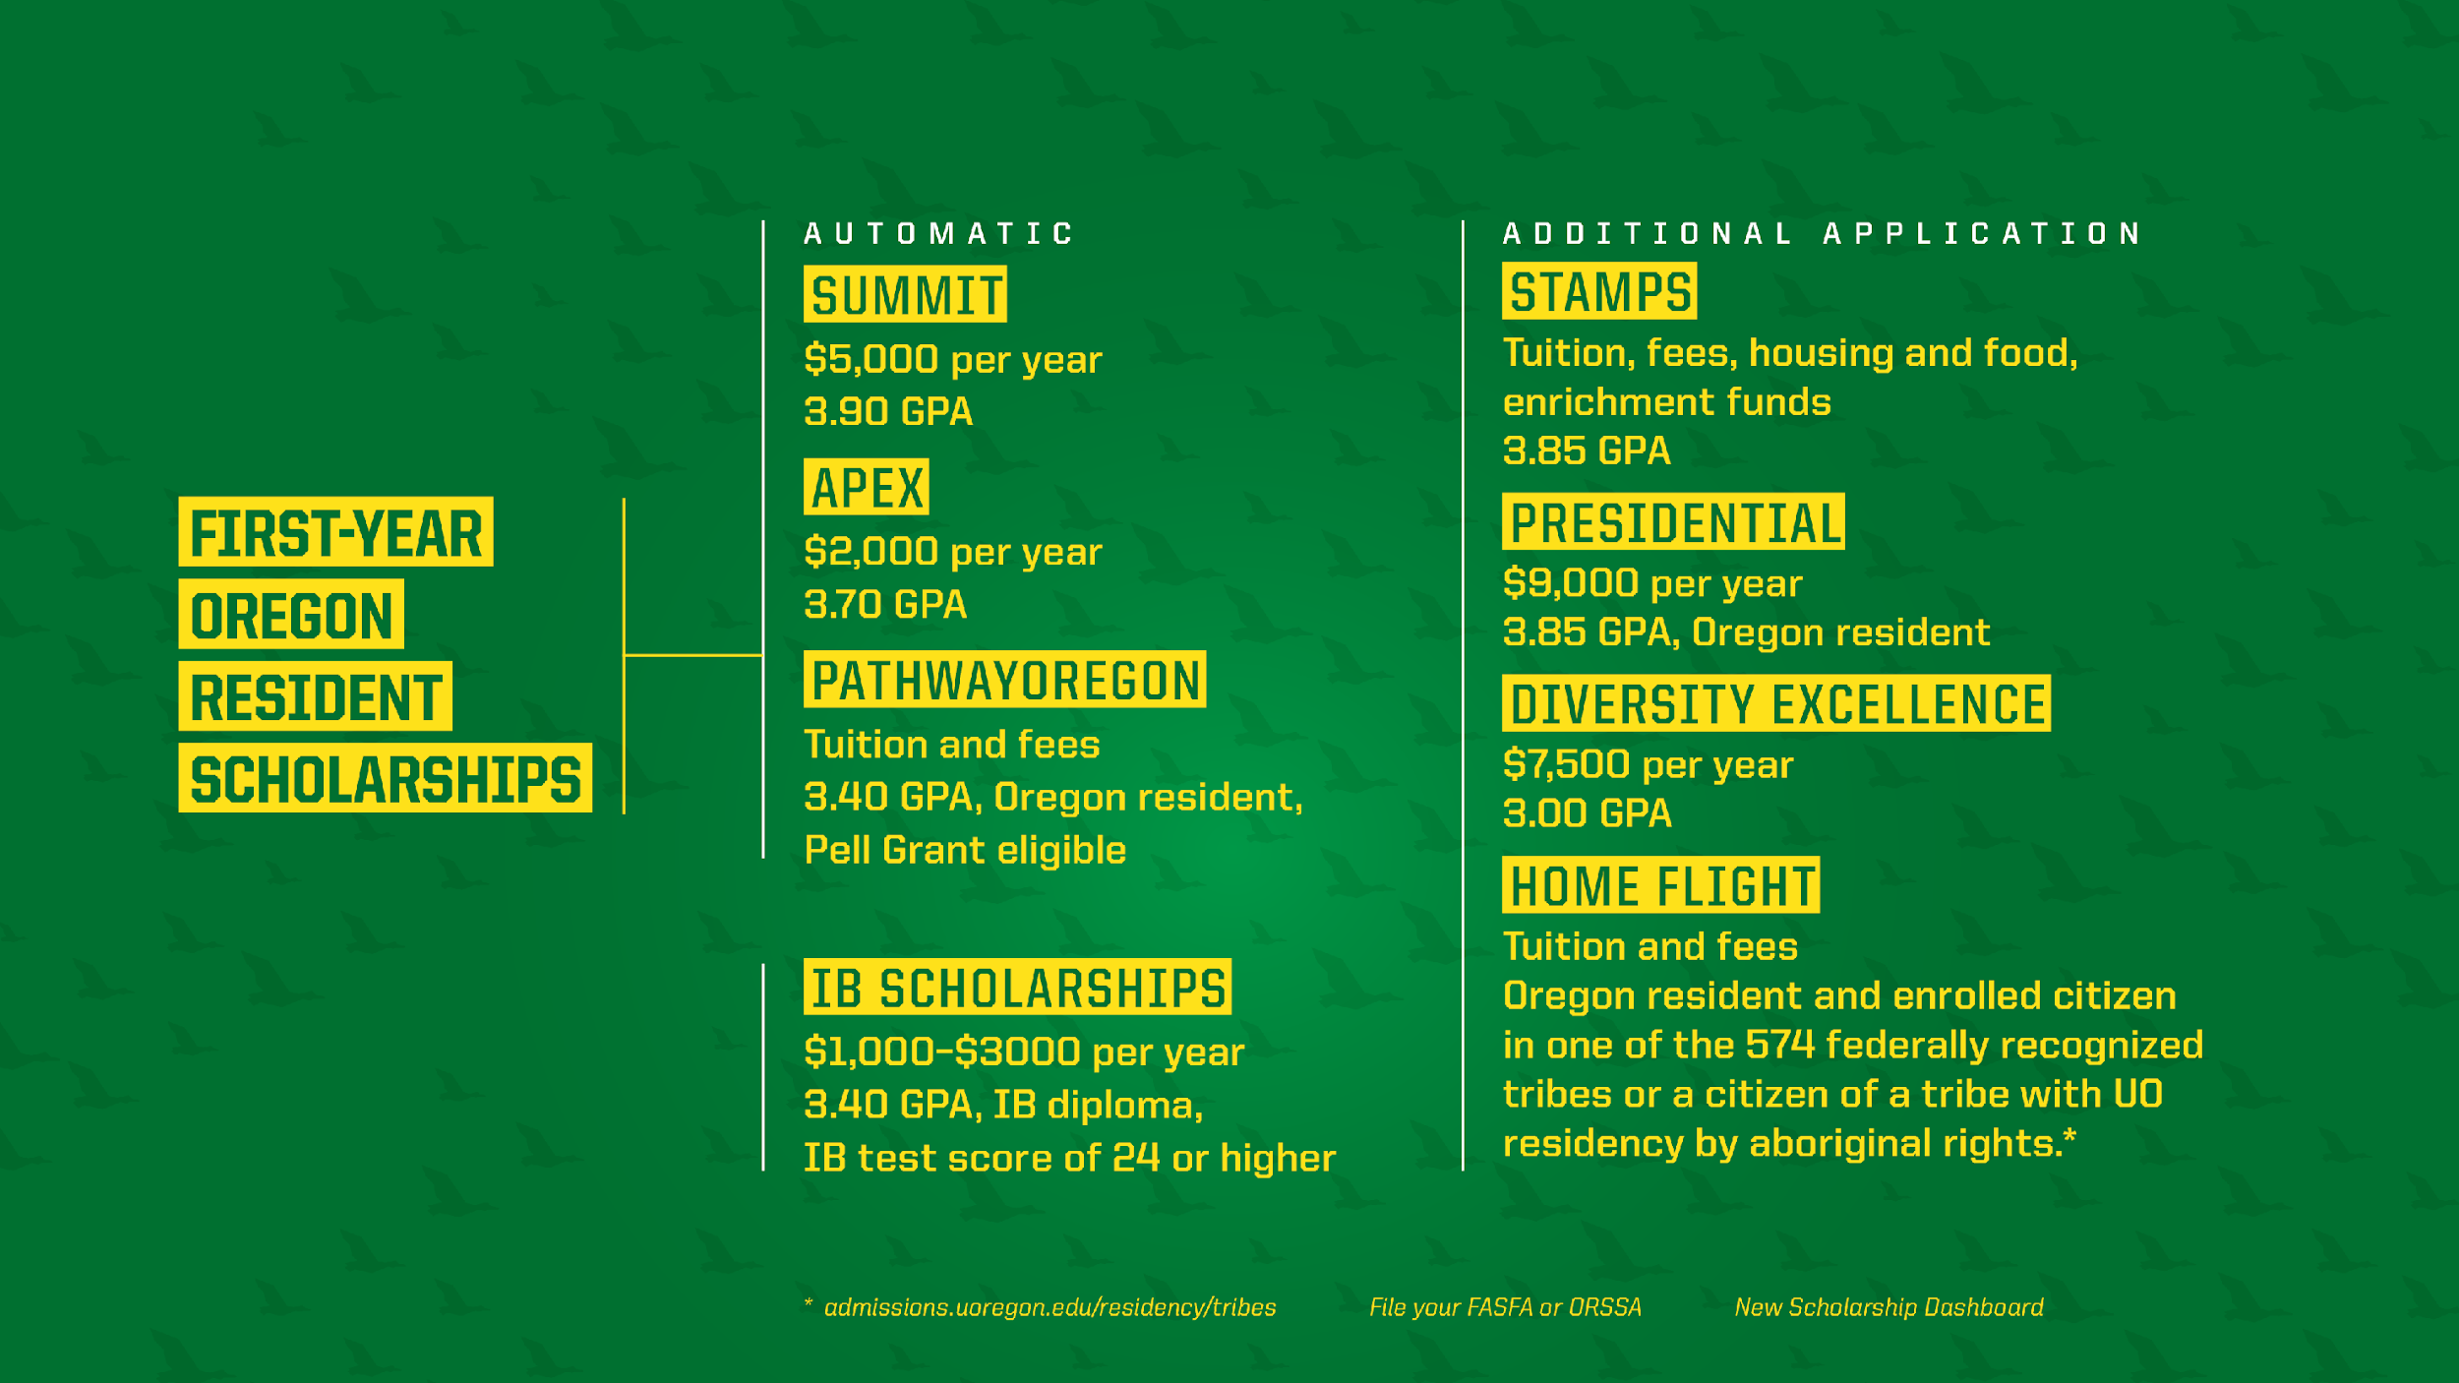

Slide 16

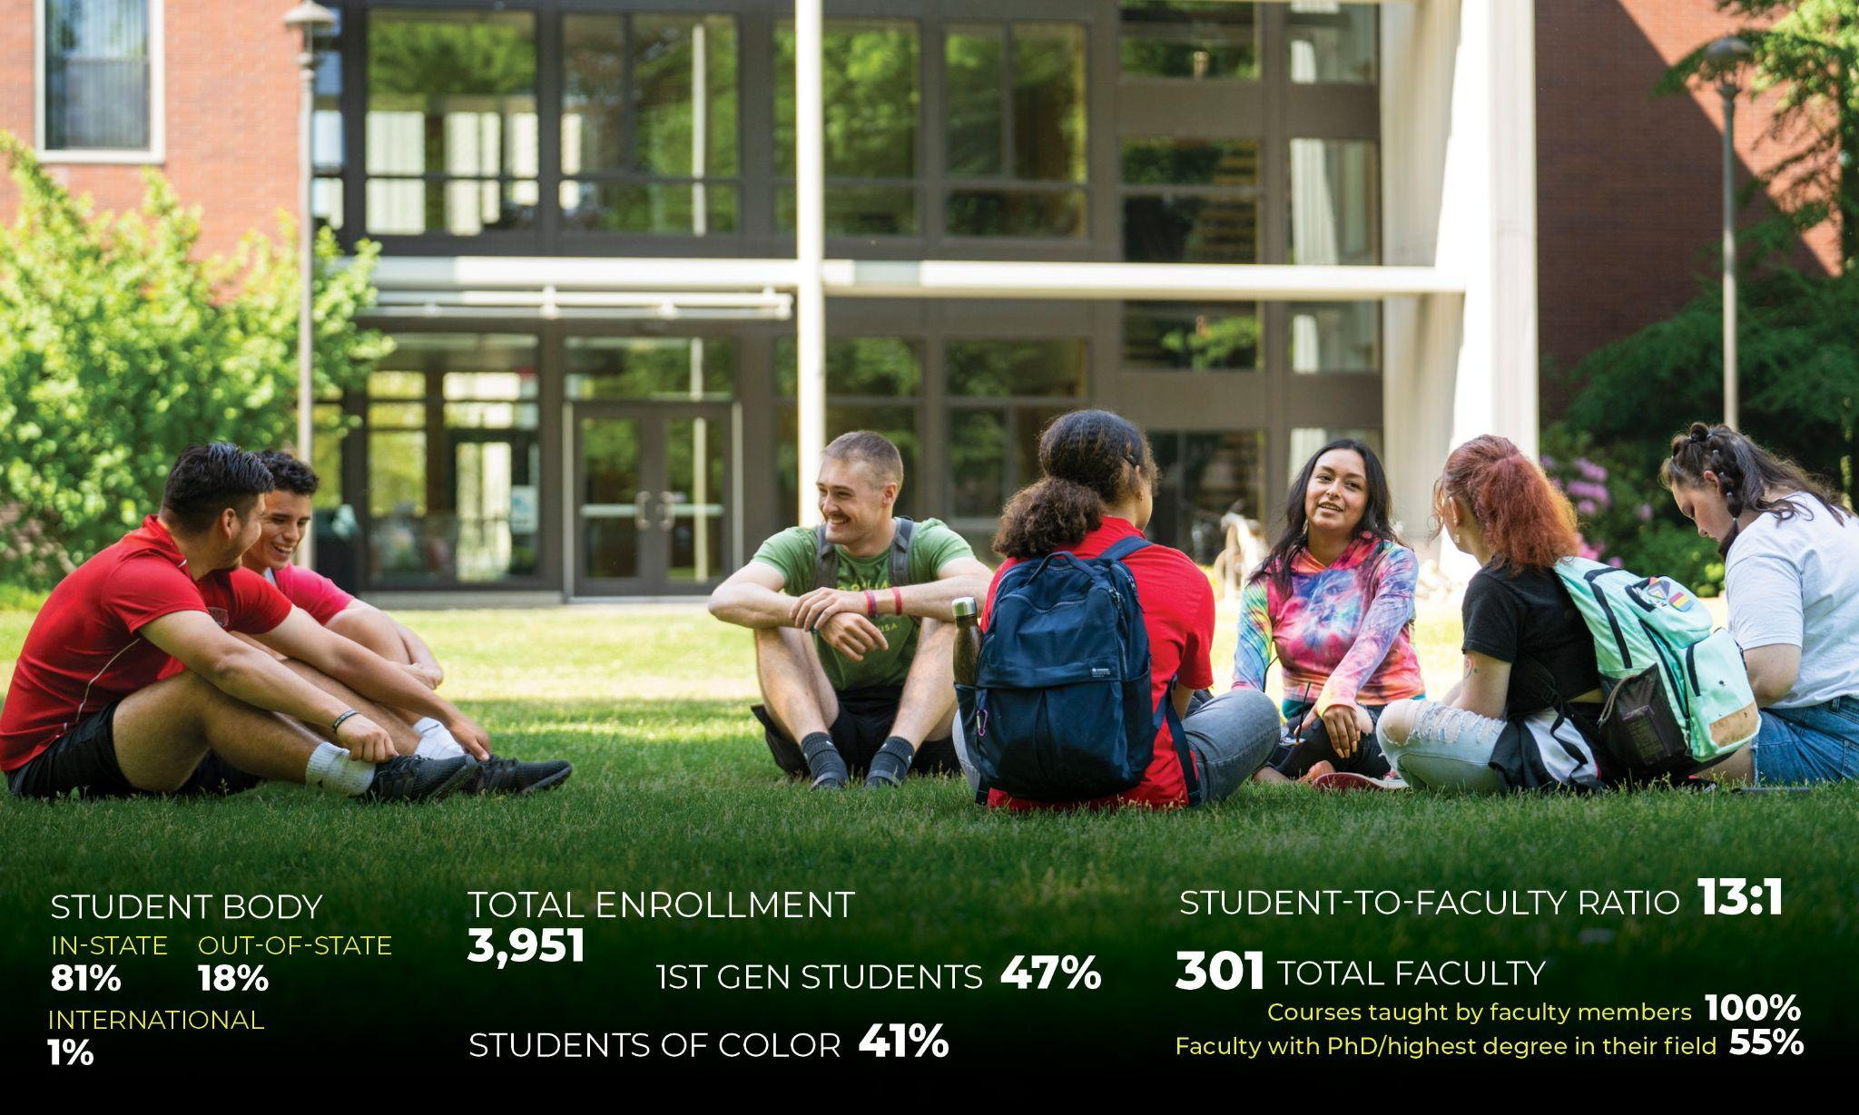

Slide 17
